Slide 1
Introduction Typescript
Why write Typescript when you can write Javascript?
Why learn a new language?

Slide 2

Notes:
If you have written a lot of JS you know it becomes messy if you don’t following certain patterns and practices like module pattern, prototype pattern etc. It leads to lack of maintainability and lack of reuse.

Slide 3
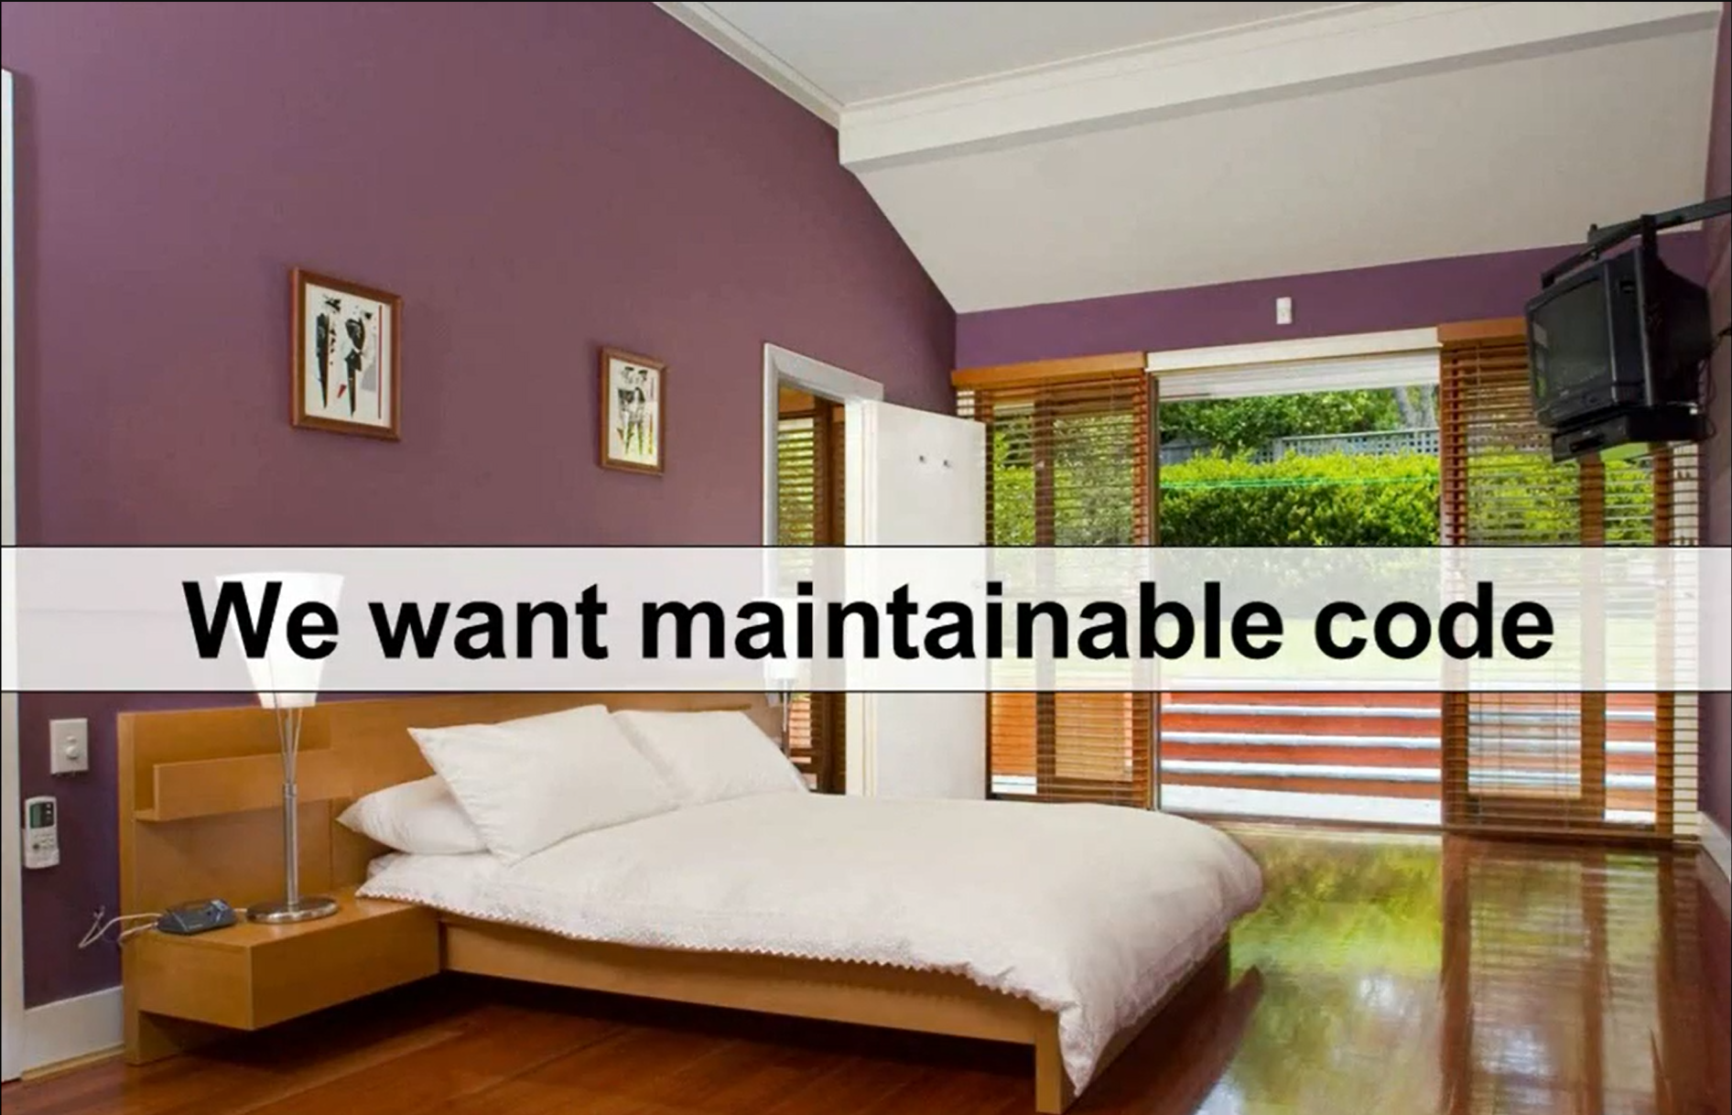
Notes:
Typescript can help you write clean, reusable code. Typescript is not the only way you can achieve clean and reusable code but it certainly is one of the best approaches to do that.

Slide 4
Javascript Dynamic Types
Javascript provides dynamic type system
The Good
Variables can hold any object (Boolean, string, number, object literal)
Types determined on the fly
Implicit type coercion (e.g. string to number)
The Bad
Difficult to ensure proper types are passed without tests
Not all developers use ===
Enterprise-scale apps can have 1000s of lines of code
Notes:
With implicit type coercion you can write code like if(1 == “1”) and it will work. But sometimes you don’t want to do that.
It is difficult to ensure that correct types are being passed from one part of code to other part of code without unit tests.
=== does not do type coercion so if you write code if(1 === “1”) it wont return true if types are different.

Slide 5
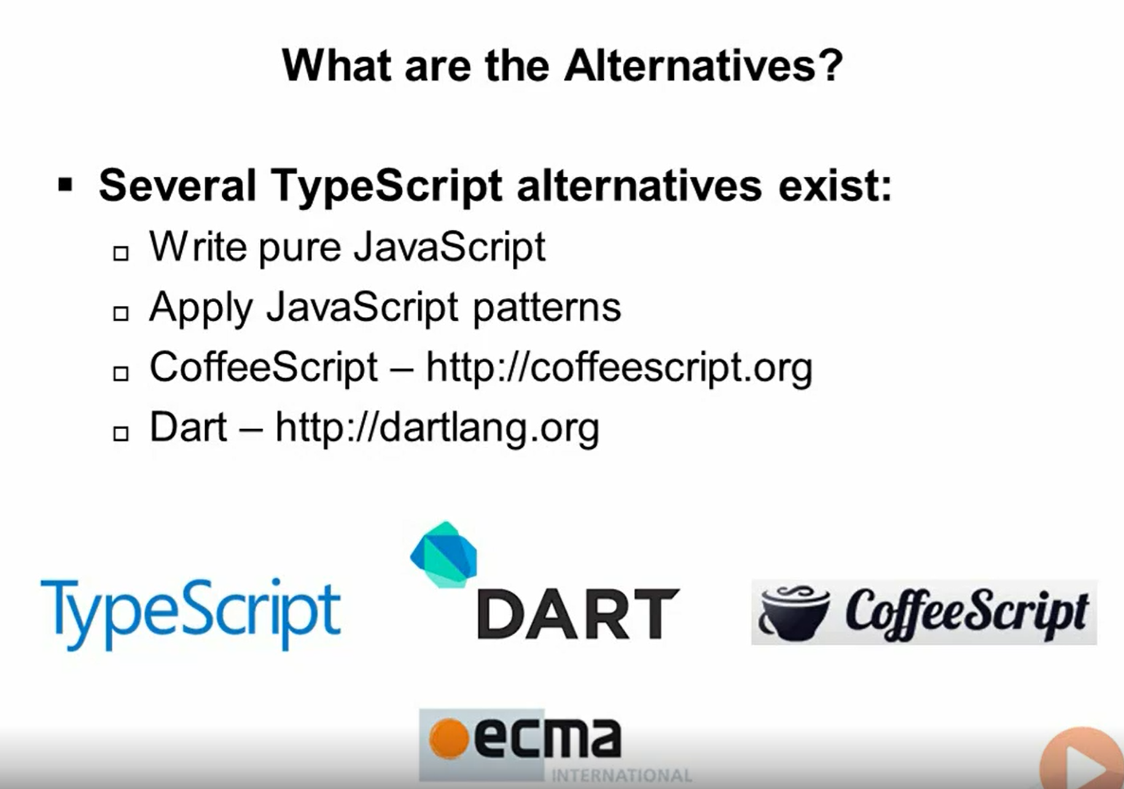

Slide 6
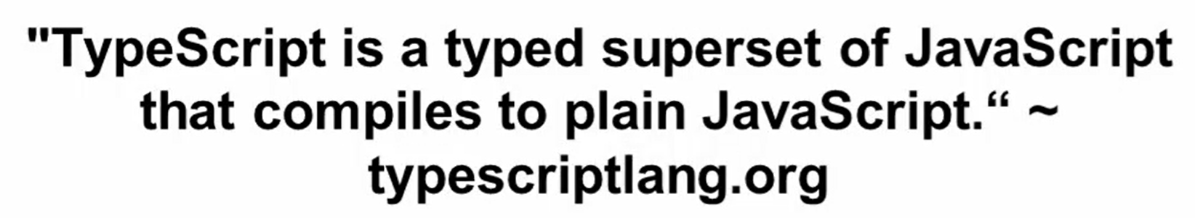
Typescript - Features

Slide 7
Flexible Options
Any browser
Any OS
Open Source
Tool Support

Slide 8
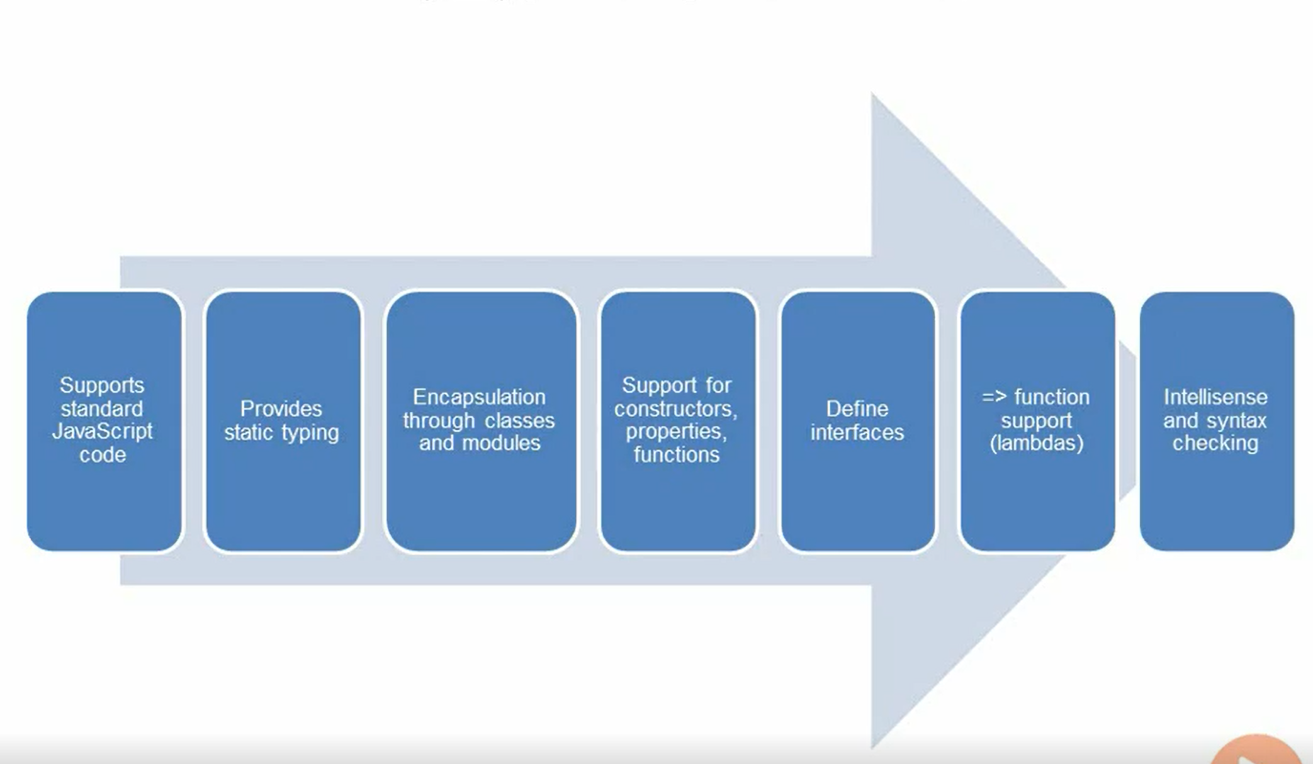
Key Typescript Features

Slide 9
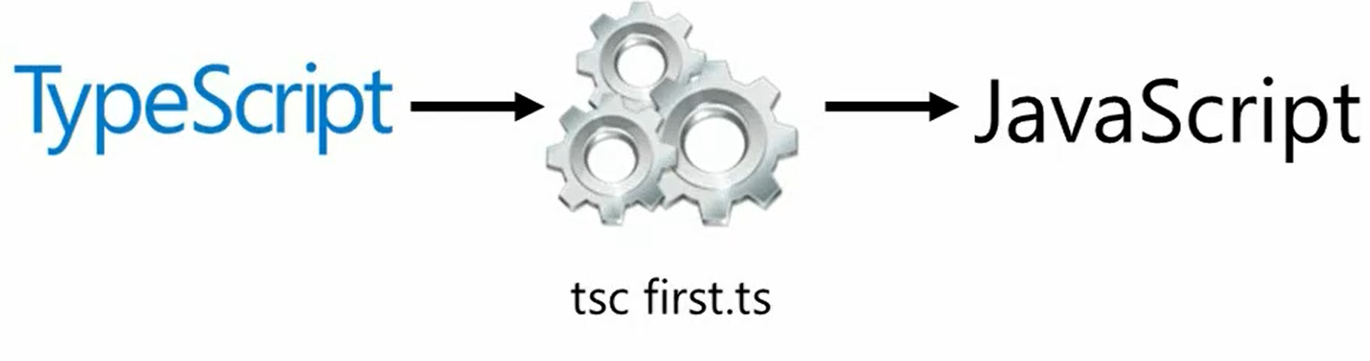
Typescript Compiler

Slide 10
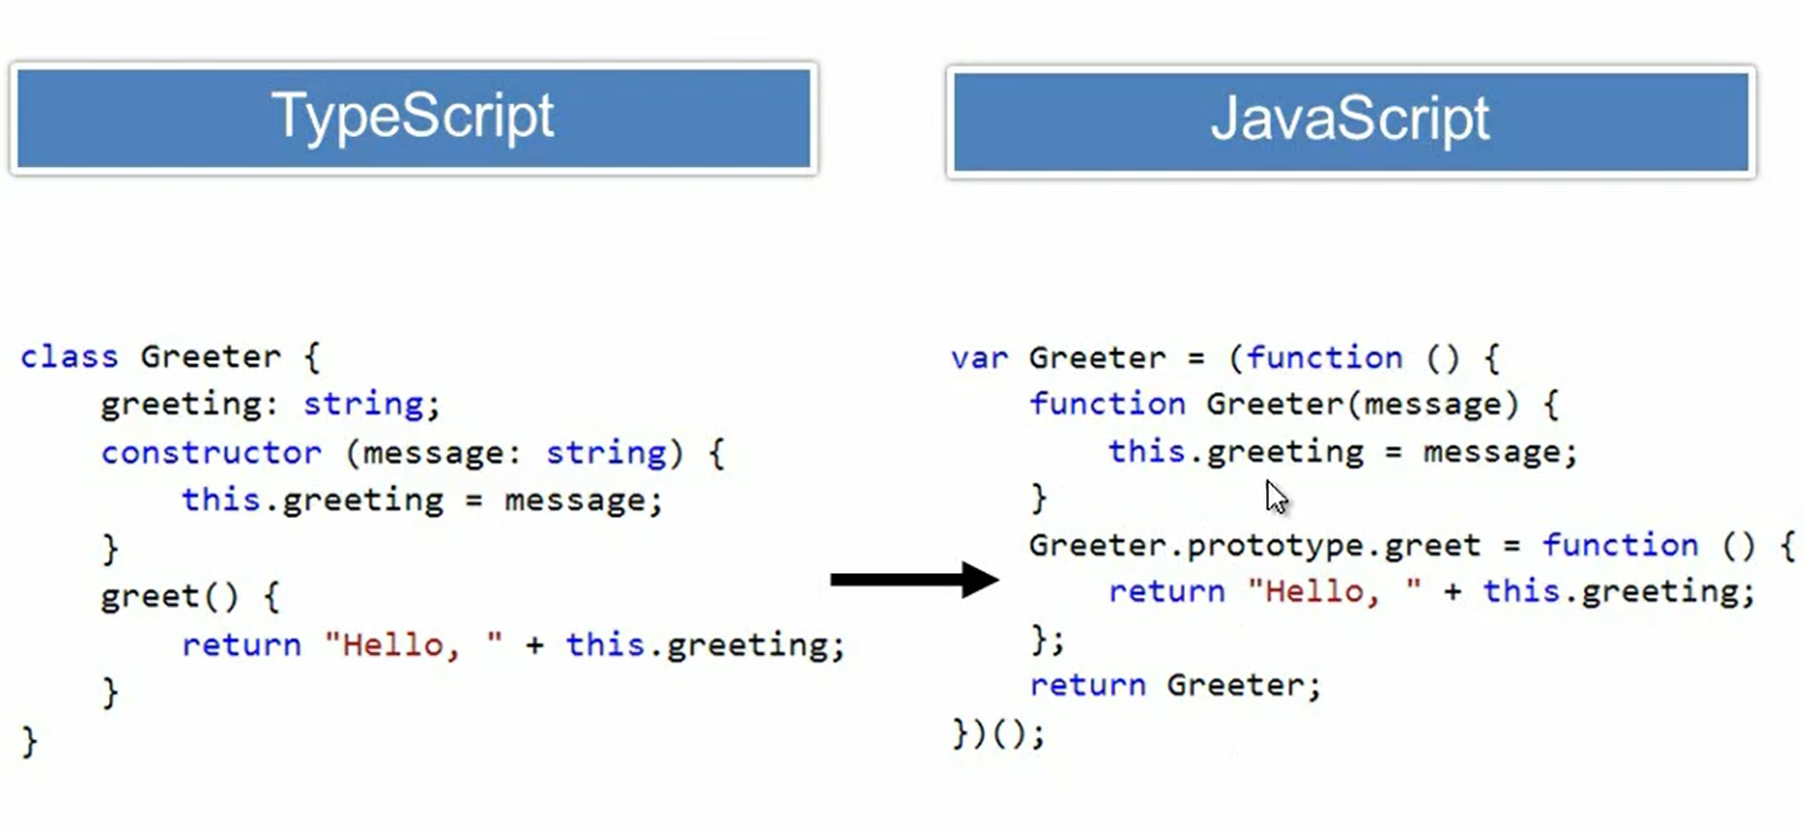

Slide 11
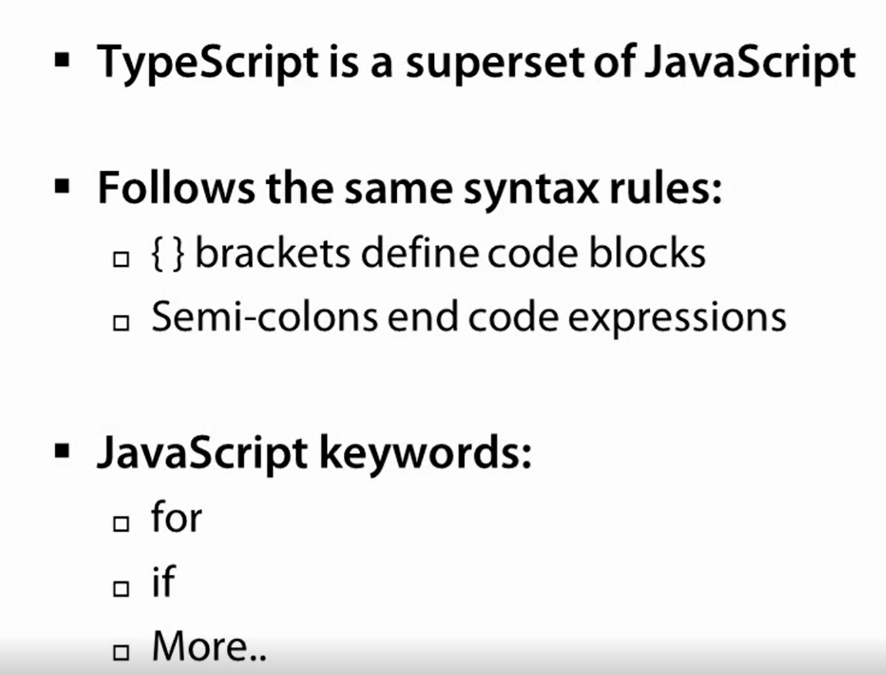
Typescript Syntax Rules

Slide 12
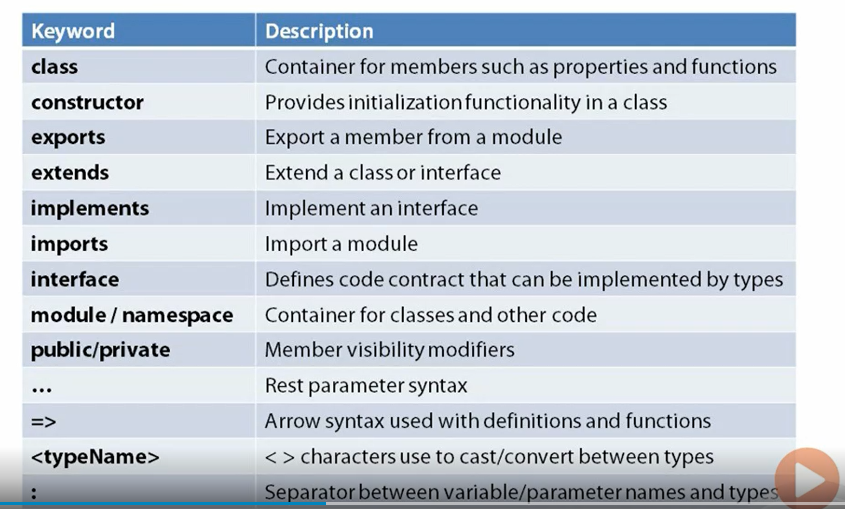
Important Keywords

Slide 13
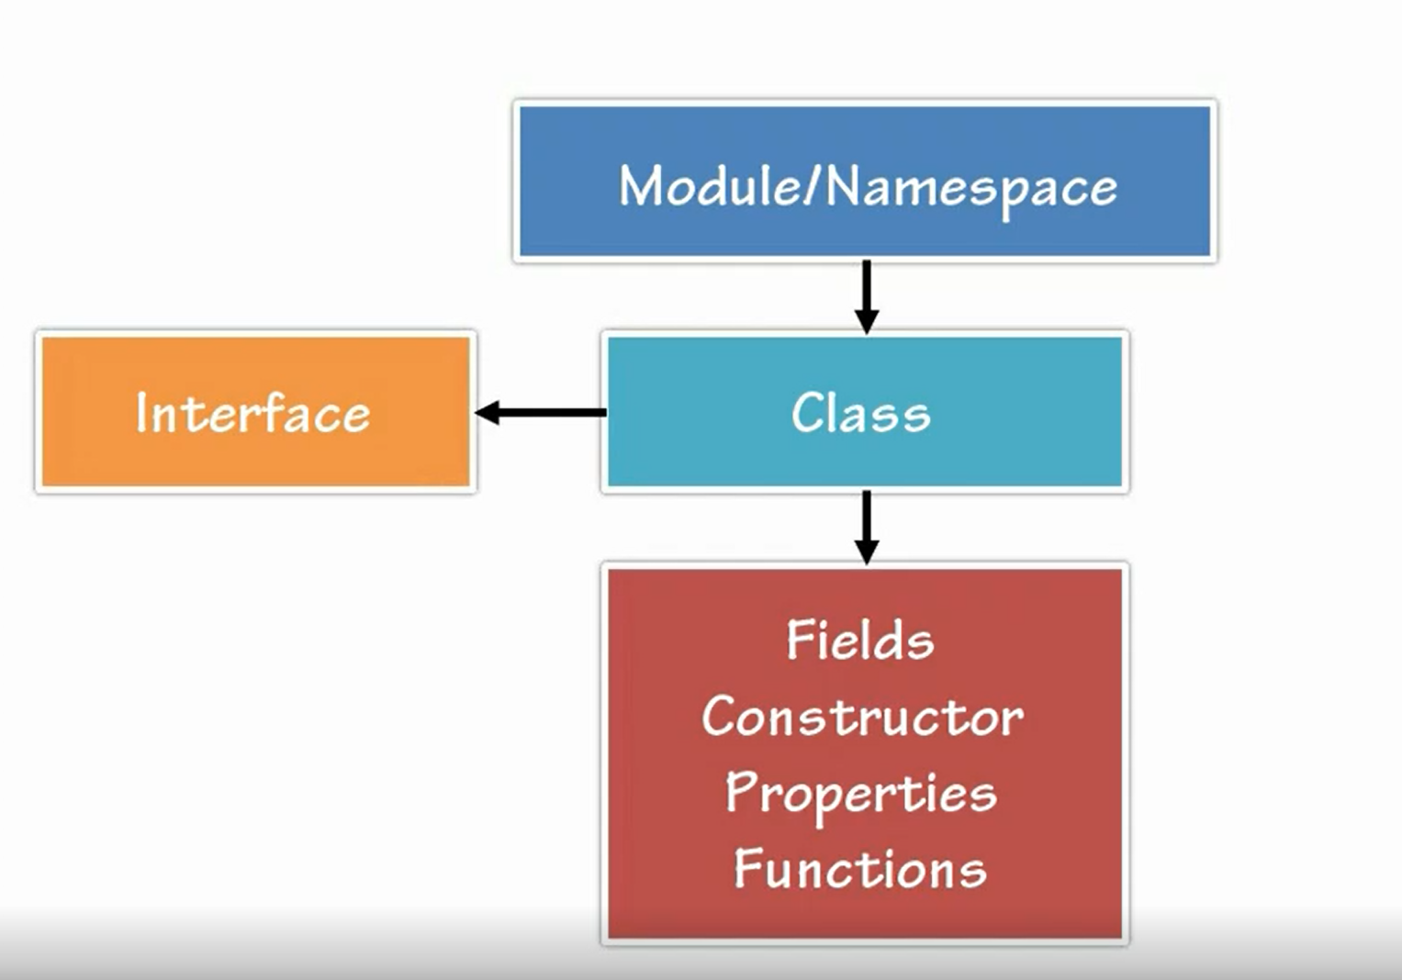
Code Hierarchy

Slide 14
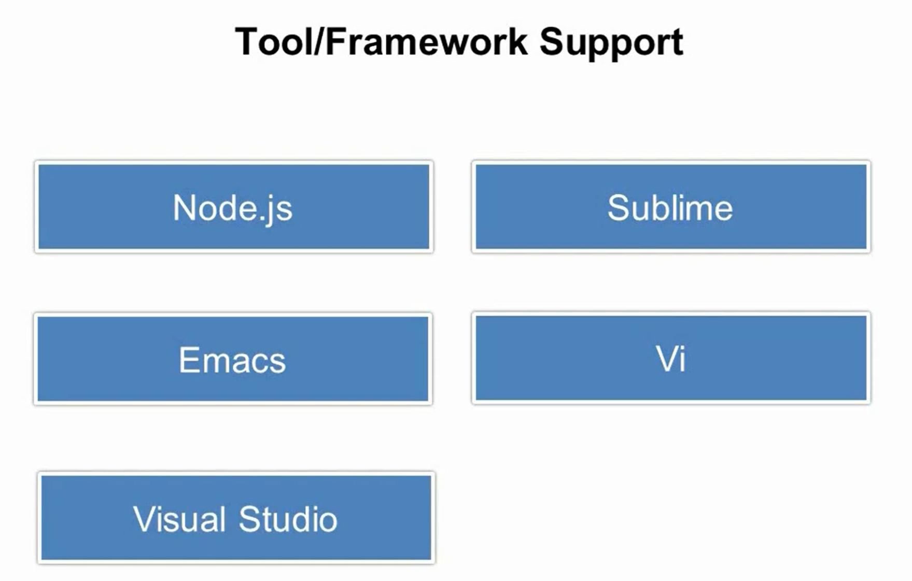
Notes:
http://fiddlesalad.com/typescript/

Slide 15
Typescript Compilation using tsc.exe
Some code editors like Visual Studio provide Typescript complication OOB
But if you are writing code against node.js you might want to compile your Typescript to Javascript as part of build process using “tsc.exe”.

Slide 16

Typing, Variables and Functions
Notes:
We will talk about core features of Typescript. It will jump start into things like grammar and syntax etc. We will cover primit

Slide 17
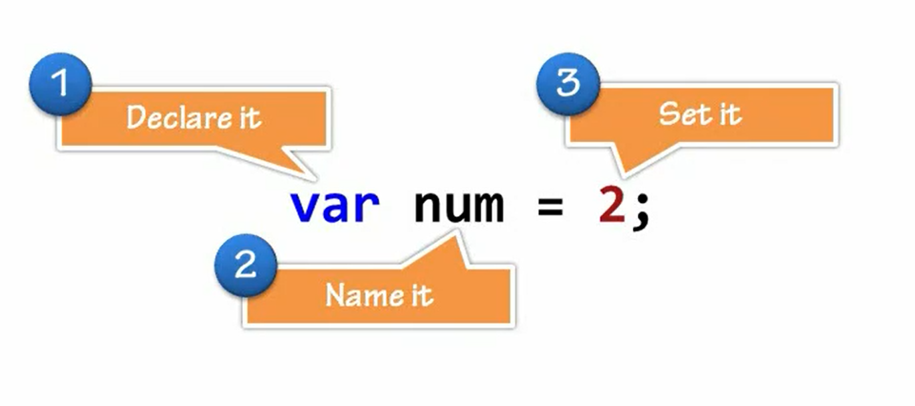
Grammar, Declarations and Annotations

Slide 18
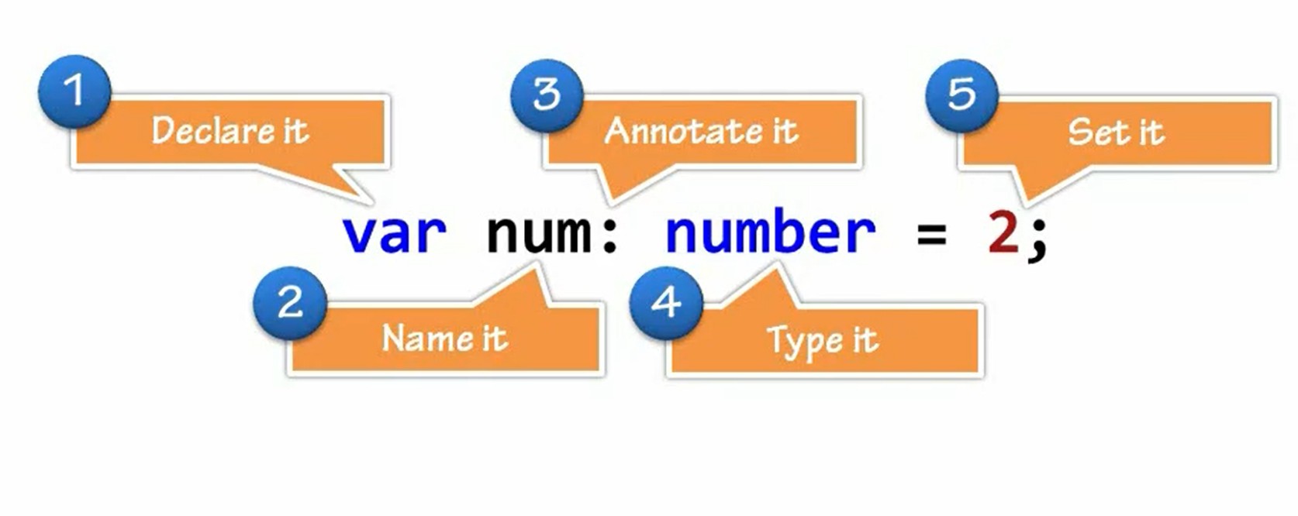
Type Annotations

Slide 19
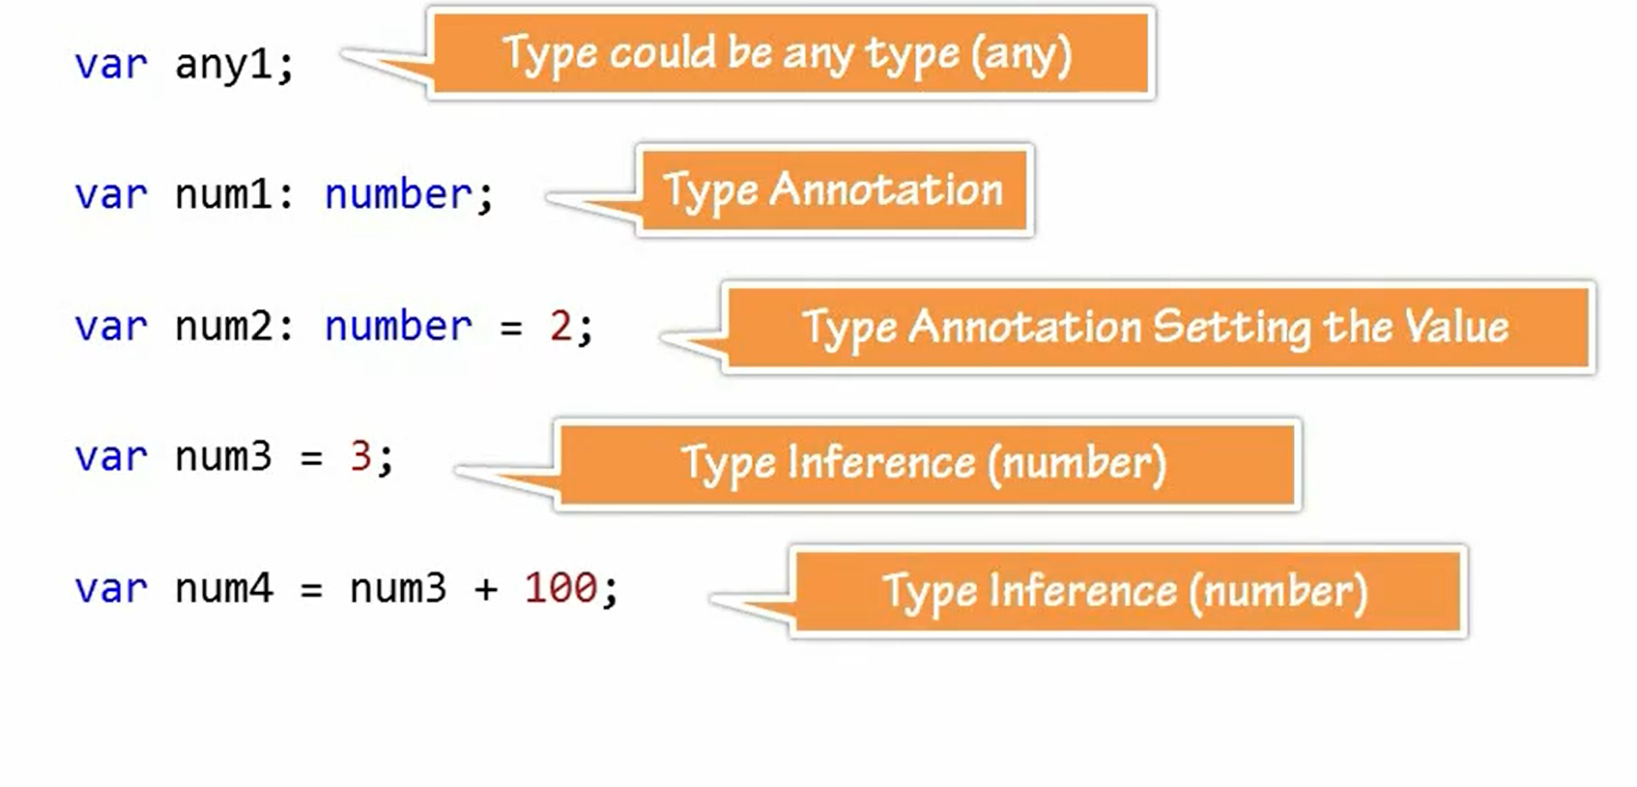
Annotation and Inferences
Notes:
Recommendation is to use line number 2.

Slide 20
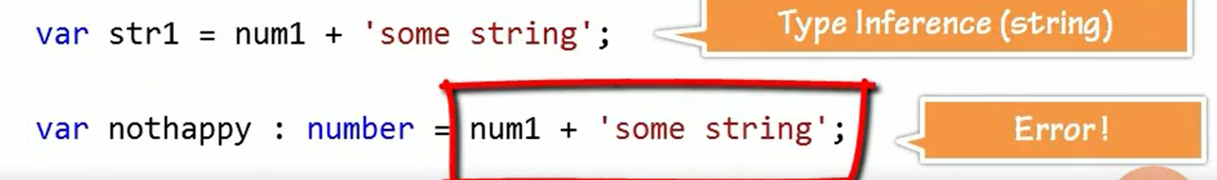
Annotation and Inferences

Slide 21
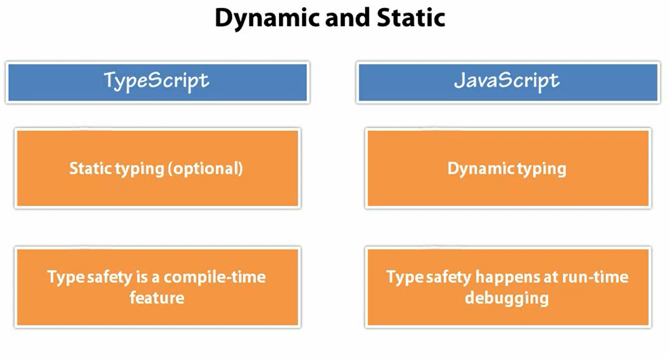

Slide 22
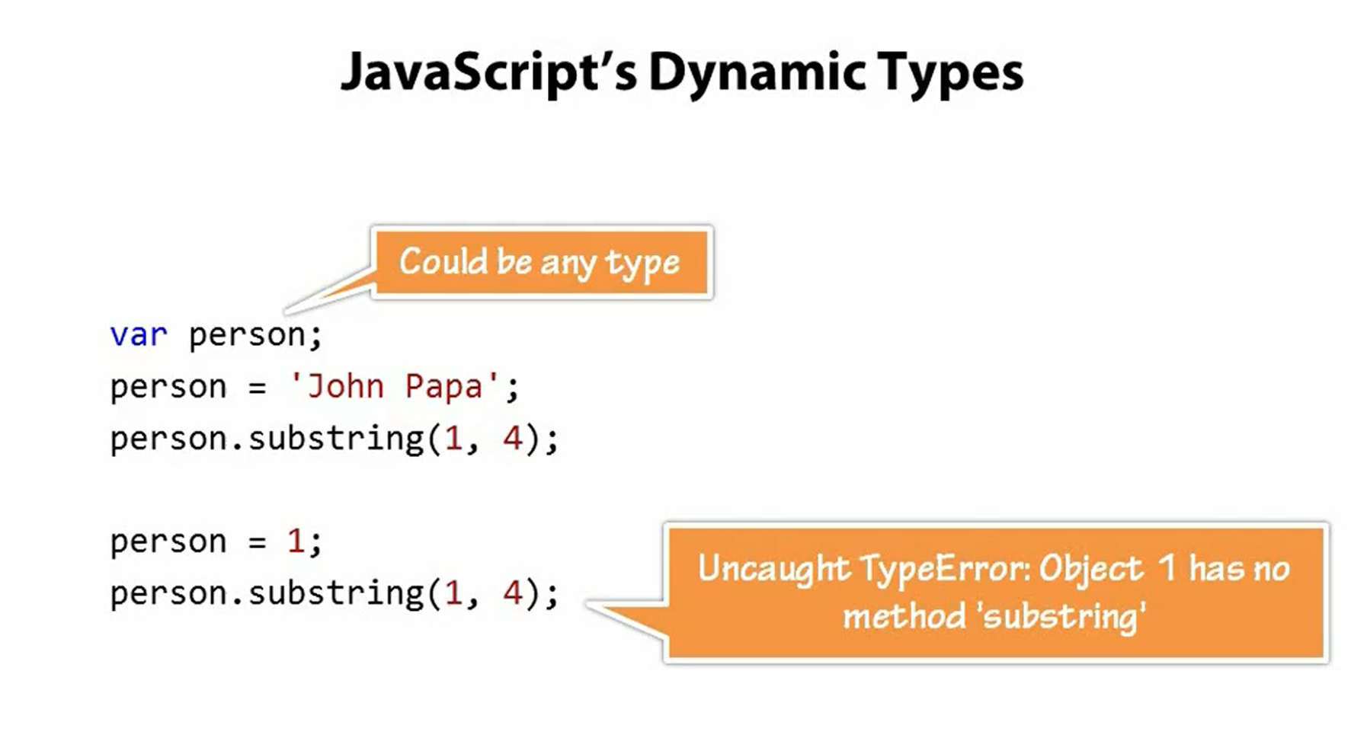

Slide 23
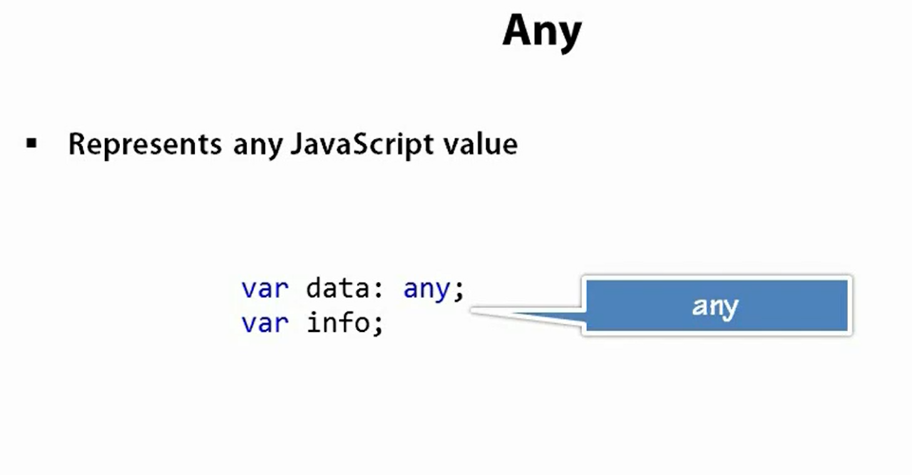
The Any Type and Premitives
Any data type can represent any Javascript value.

Slide 24
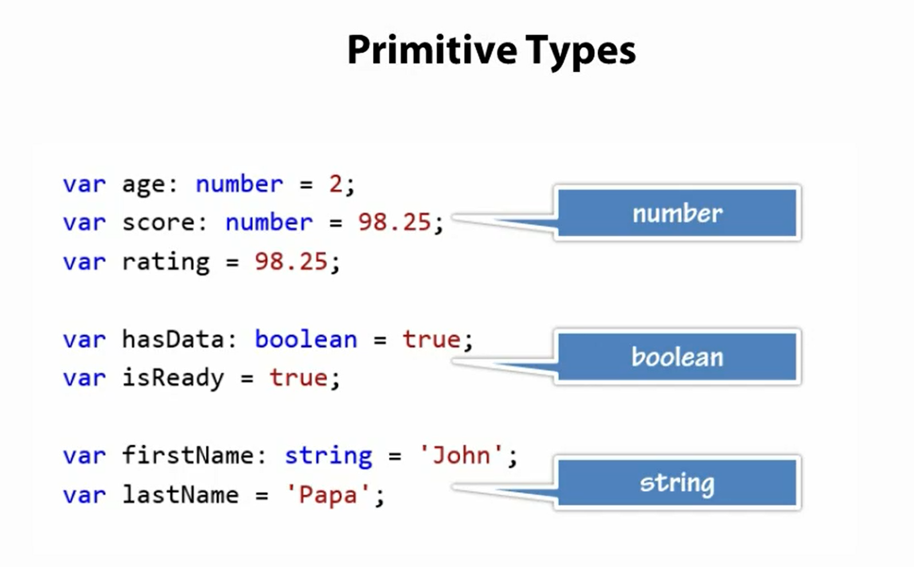

Slide 25
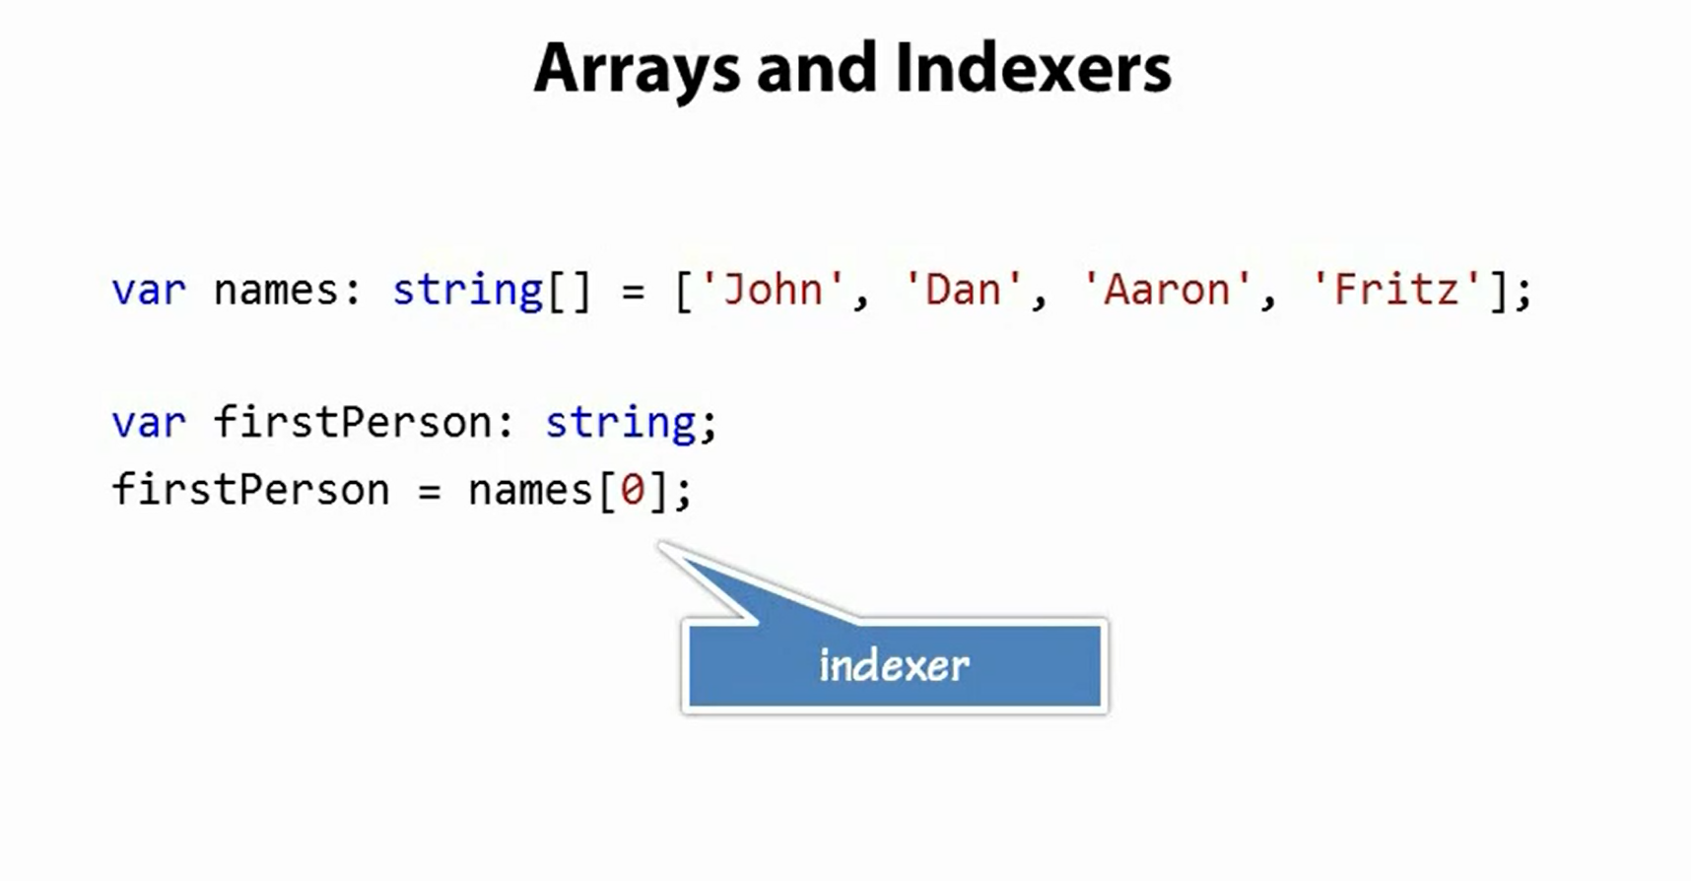

Slide 26
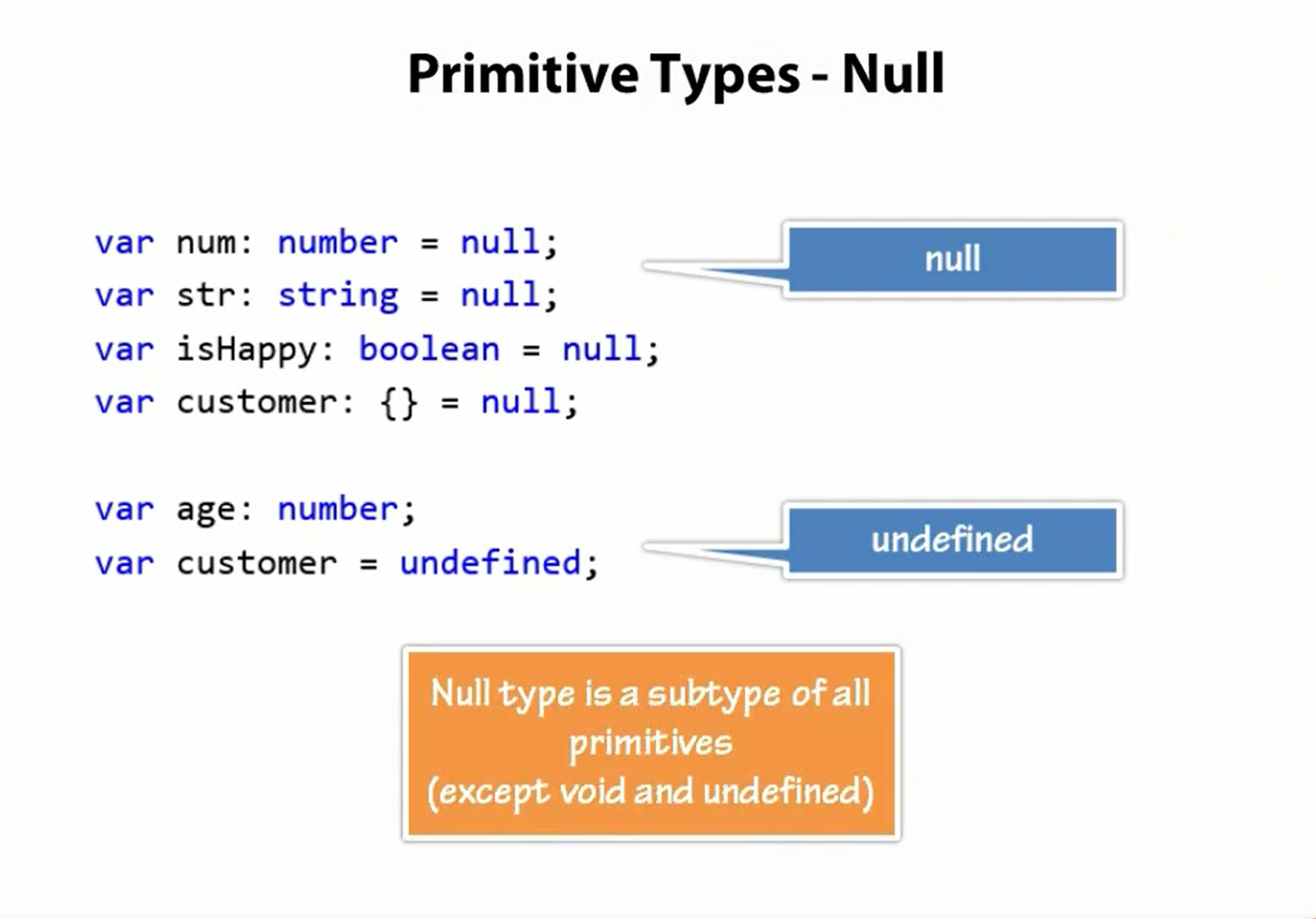

Slide 27
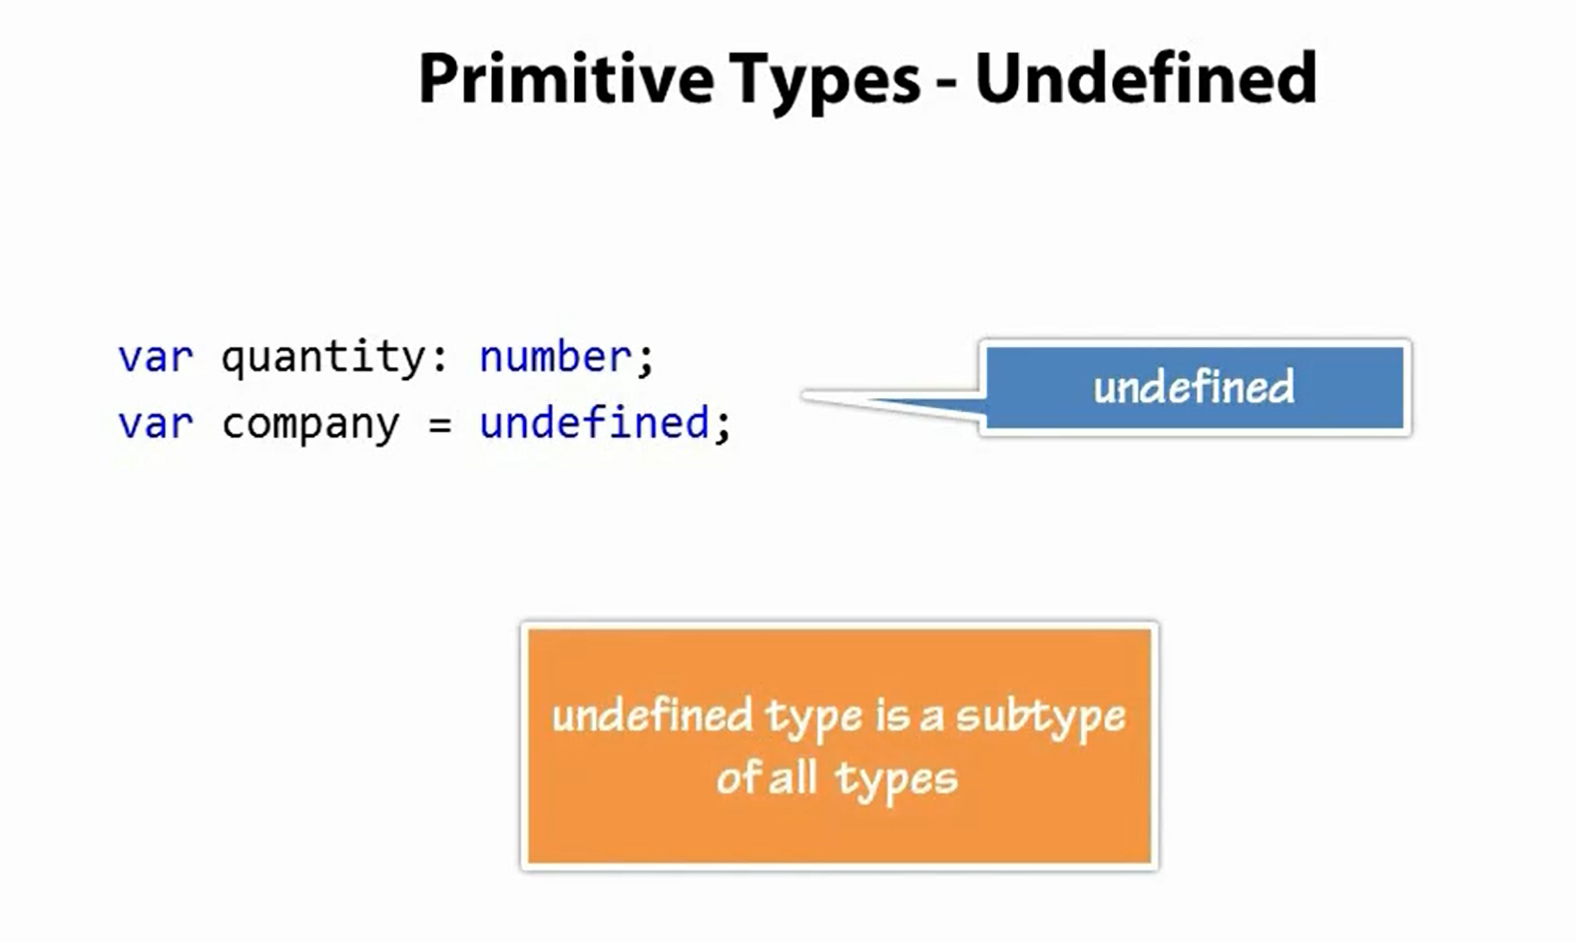

Slide 28
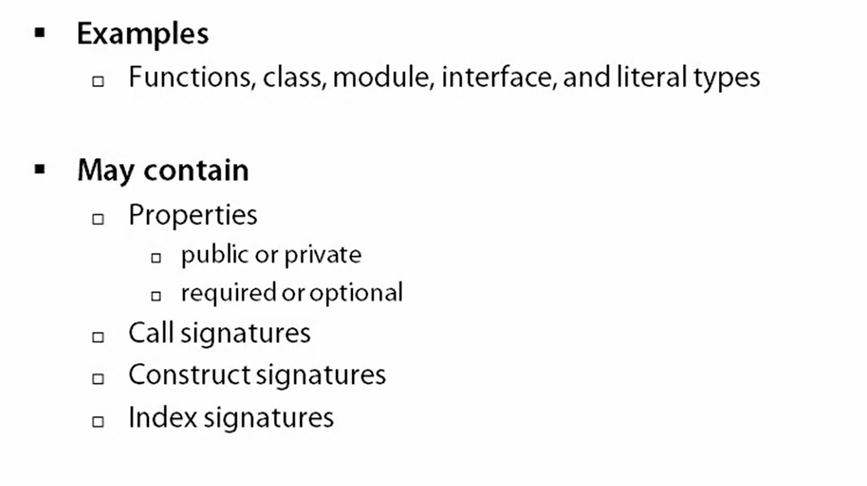
Object Types

Slide 29
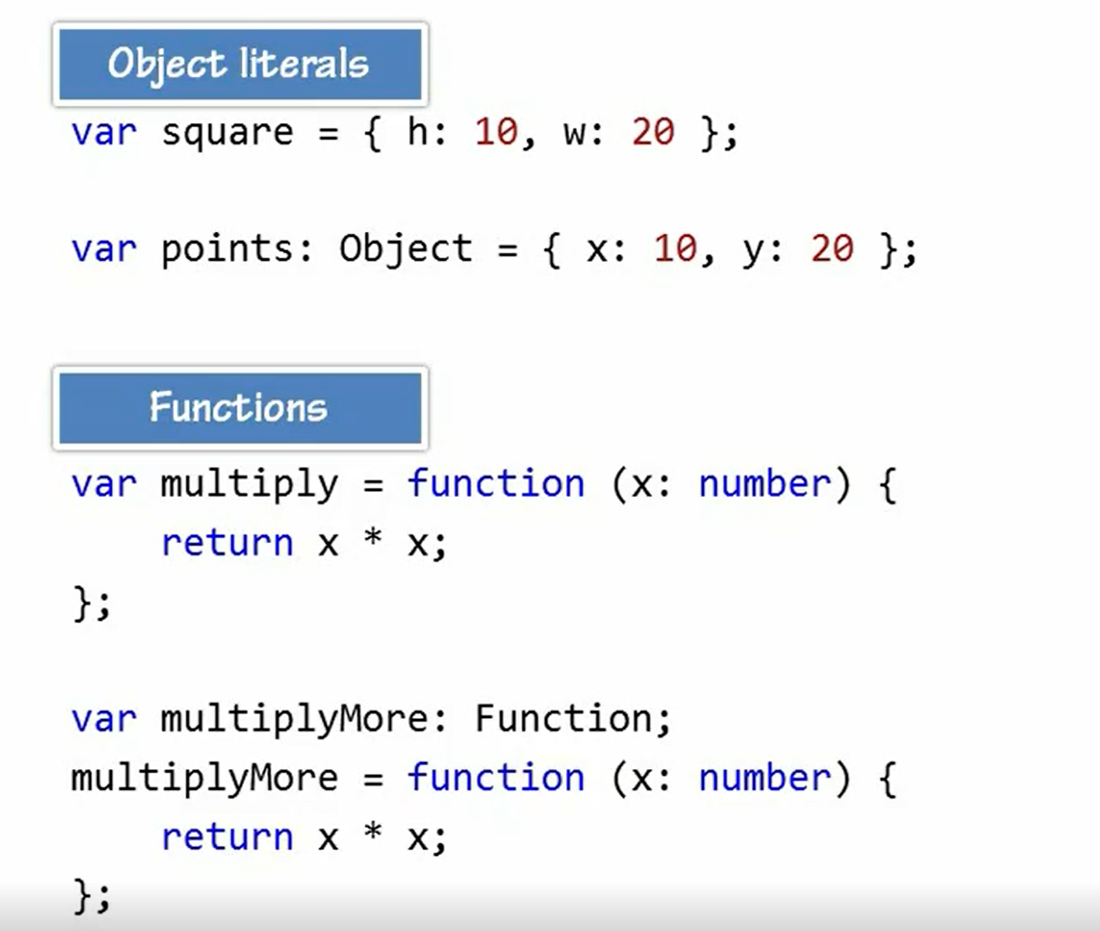

Slide 30
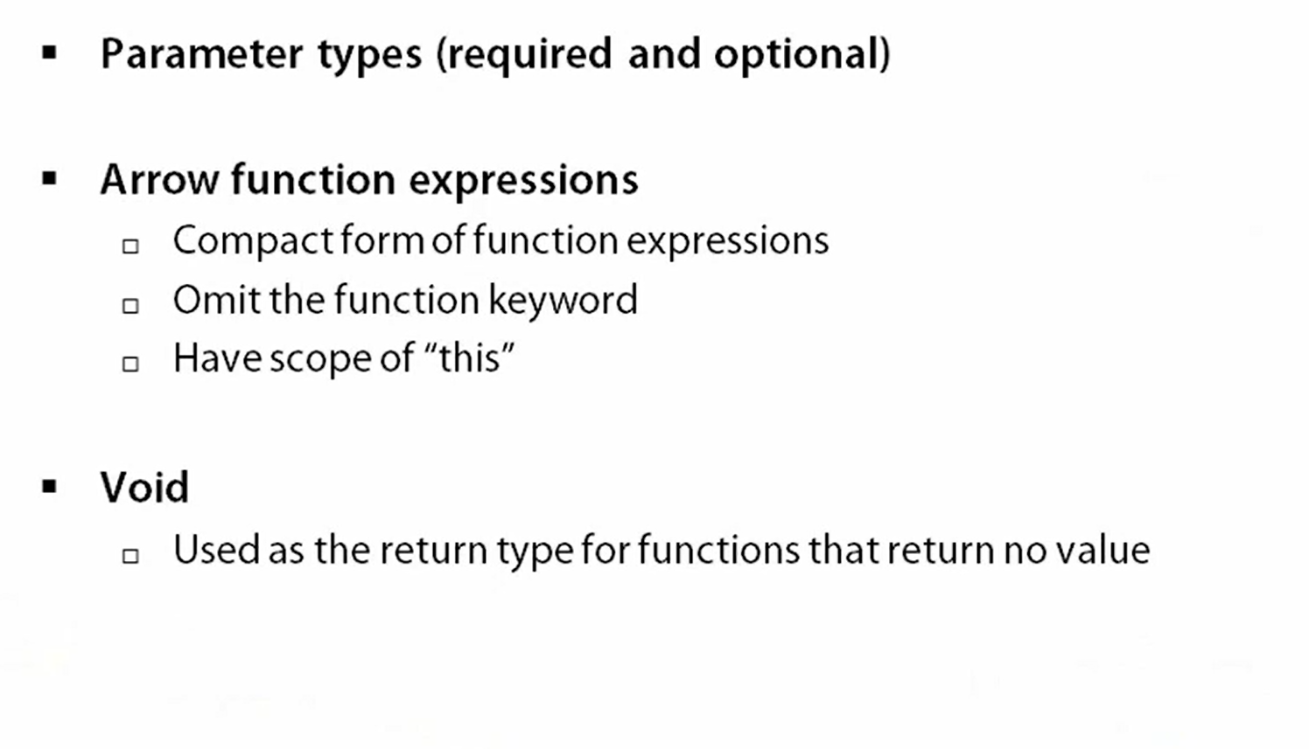
Functions

Slide 31
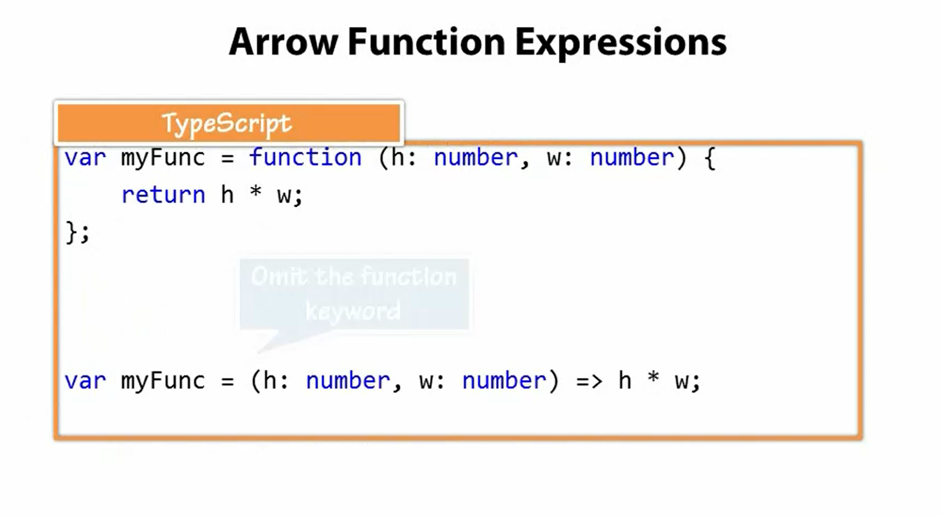

Slide 32
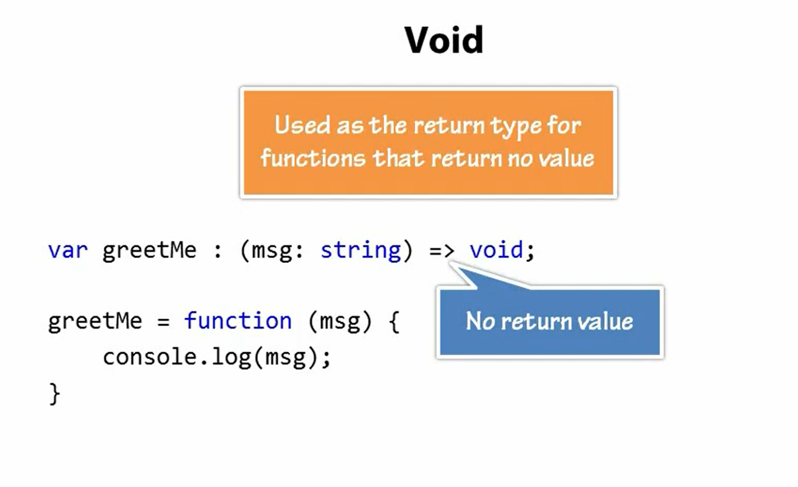

Slide 33
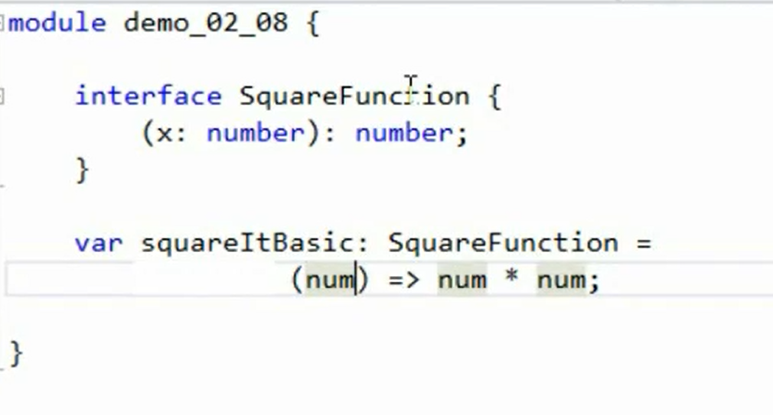
Functions and Interfaces
Notes:
To show the advantage of using interface add one more parameter called Foo to the function signature and VS will show error.

Slide 34
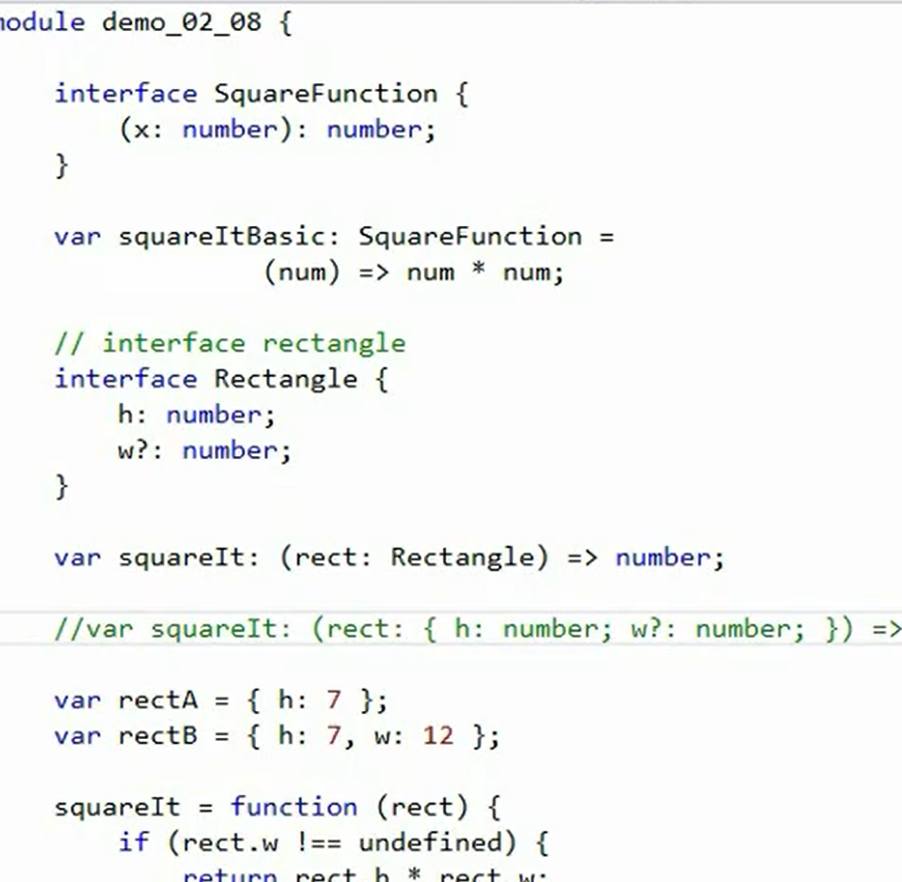

Slide 35
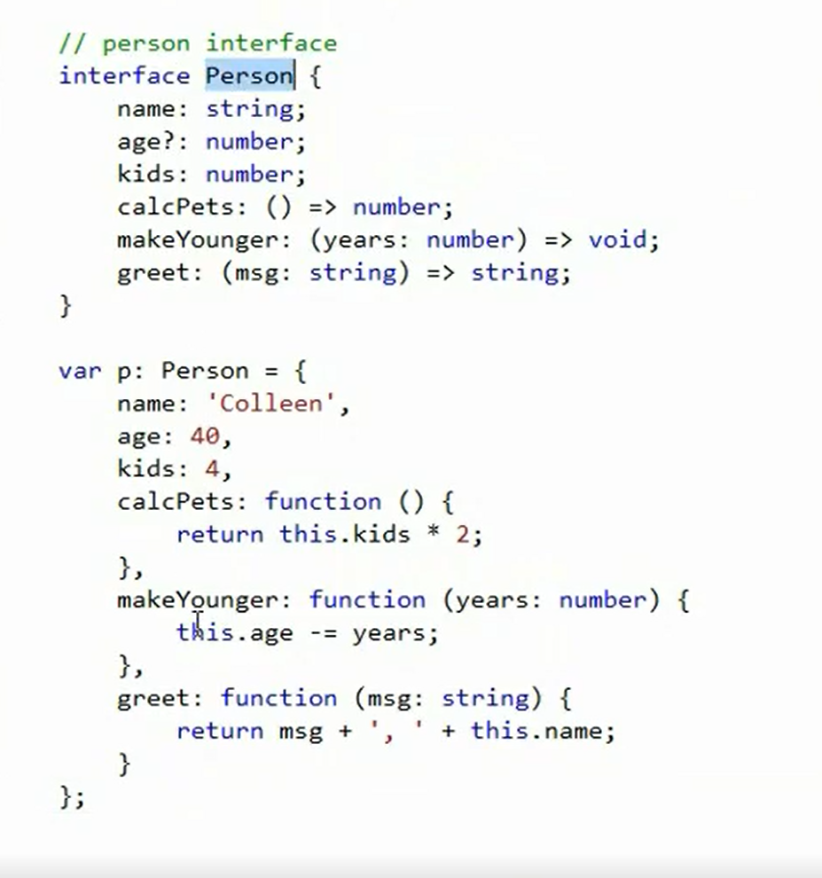
Notes:
To show the advantage of using interface add one more parameter called Foo to the function signature and VS will show error.

Slide 36
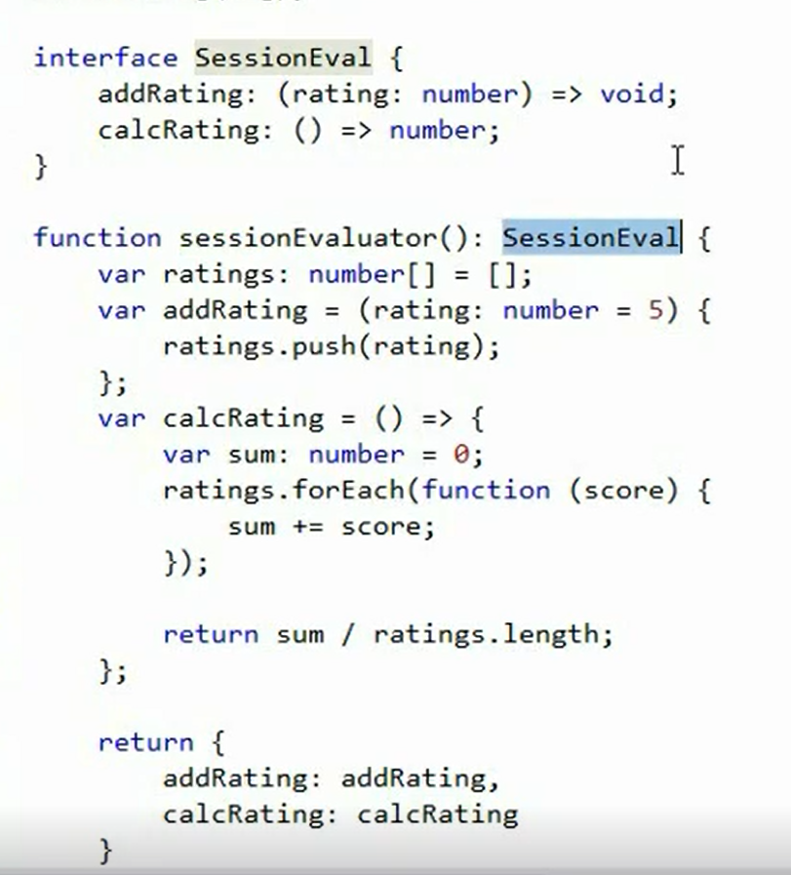
Interface to enforce return types

Slide 37
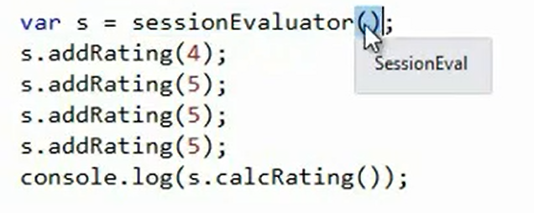

Slide 38
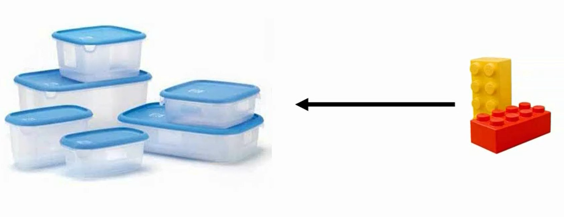
Classes and Interfaces
Typescript provides built-in support for classes
Class is just a container, it encapsulates code which can be reused

Slide 39
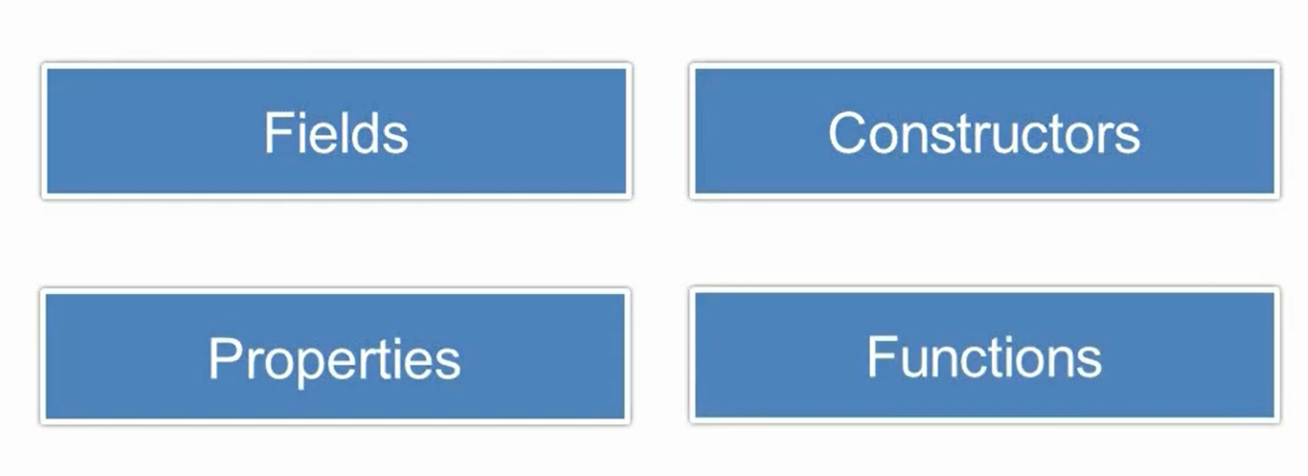
Class Members

Slide 40
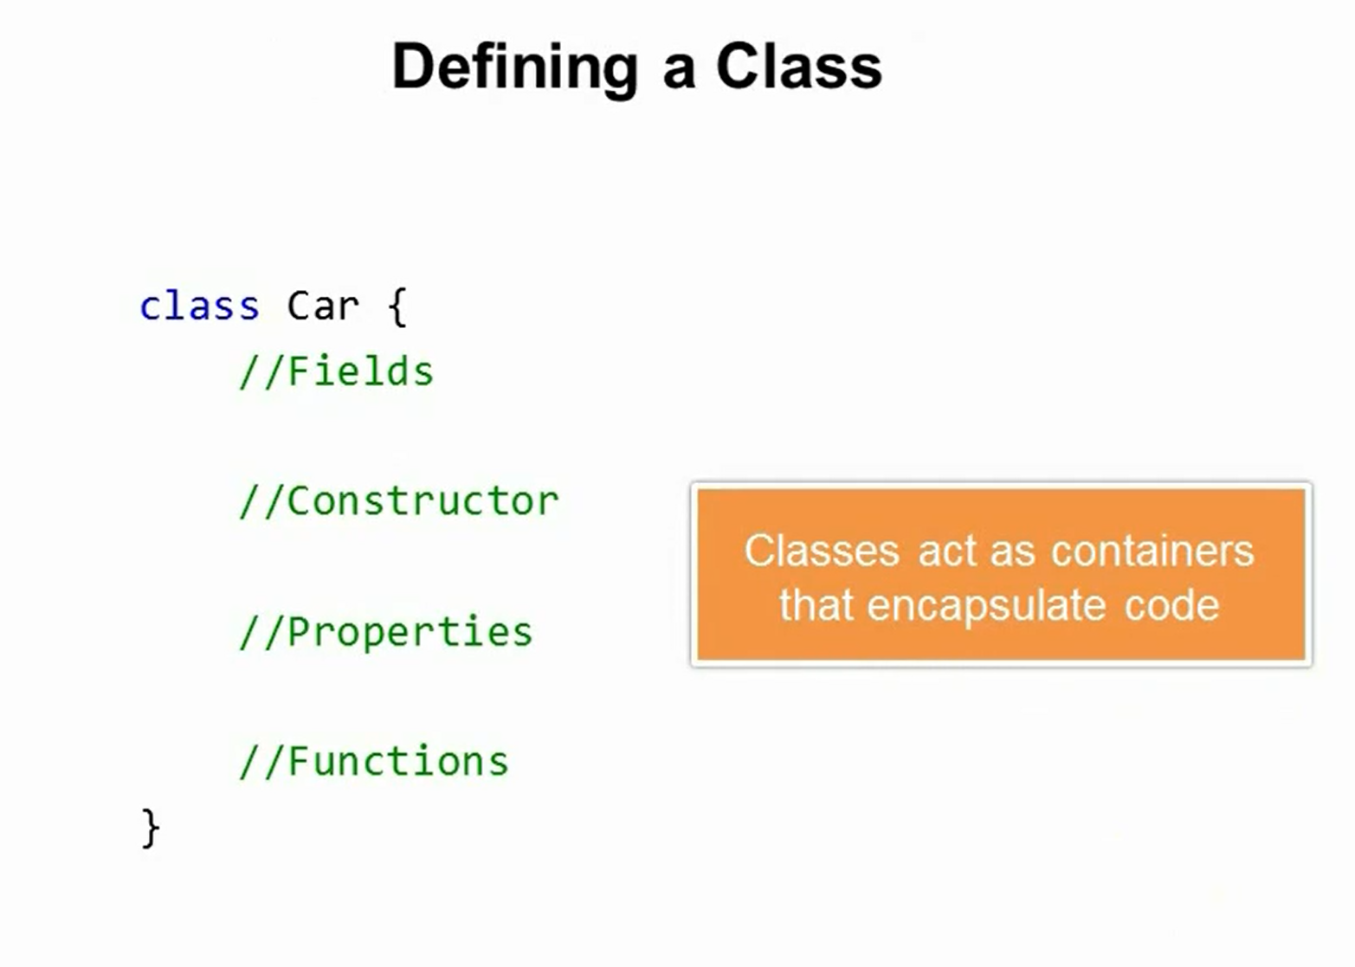

Slide 41
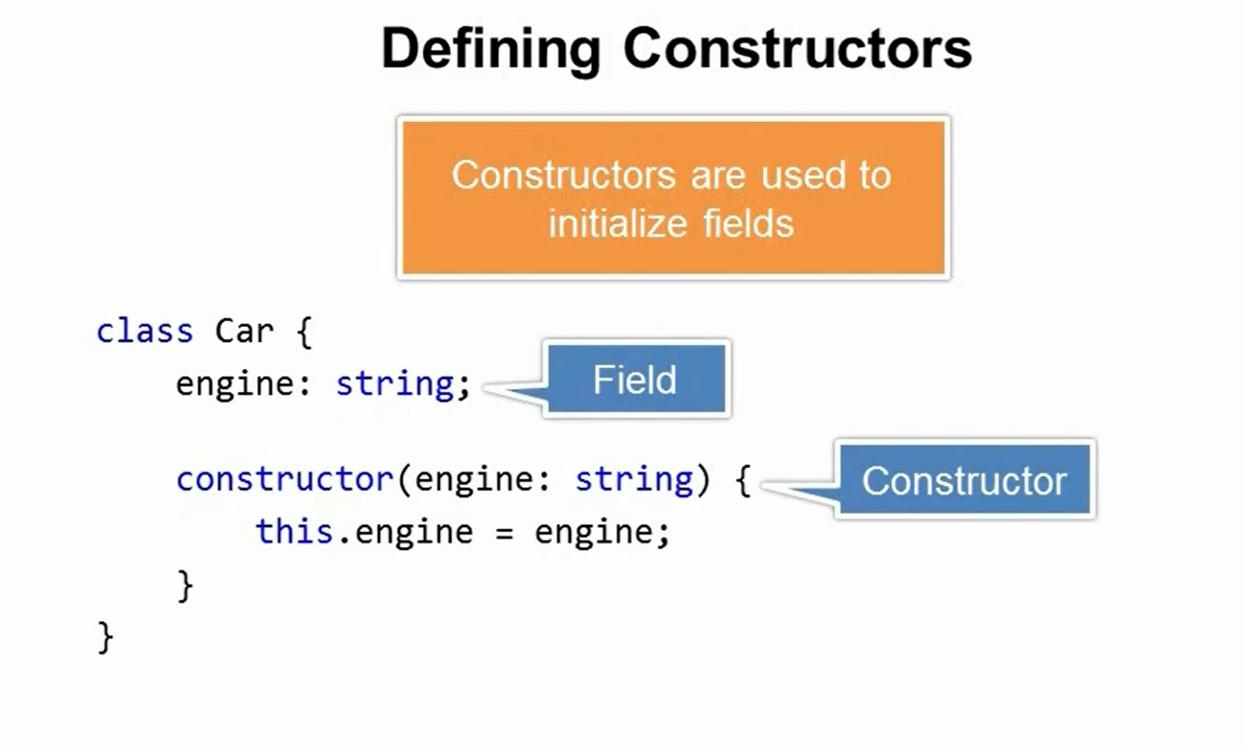

Slide 42
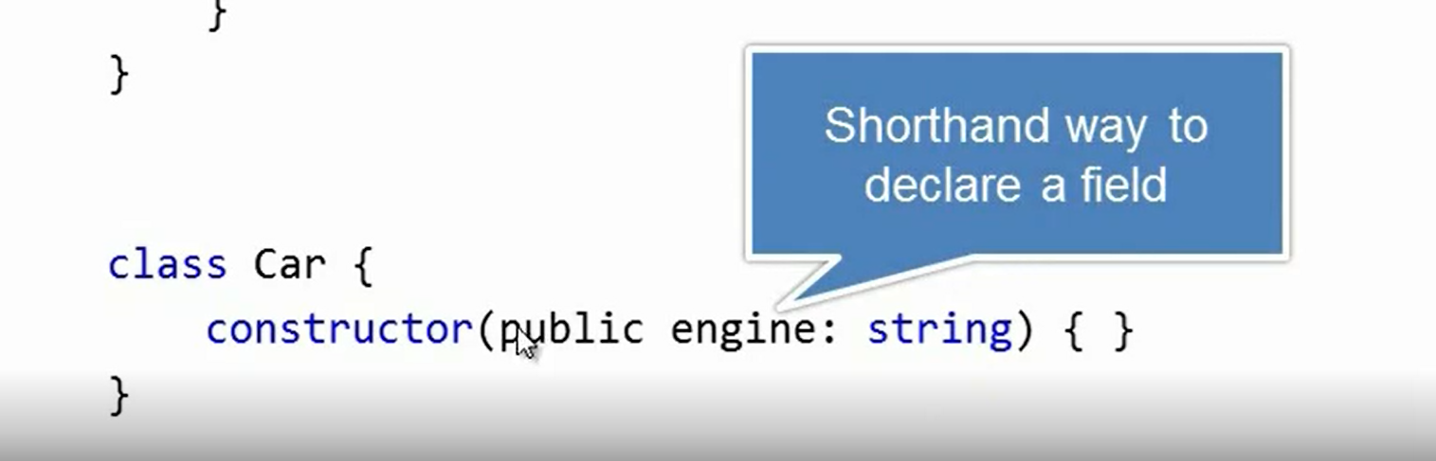

Slide 43
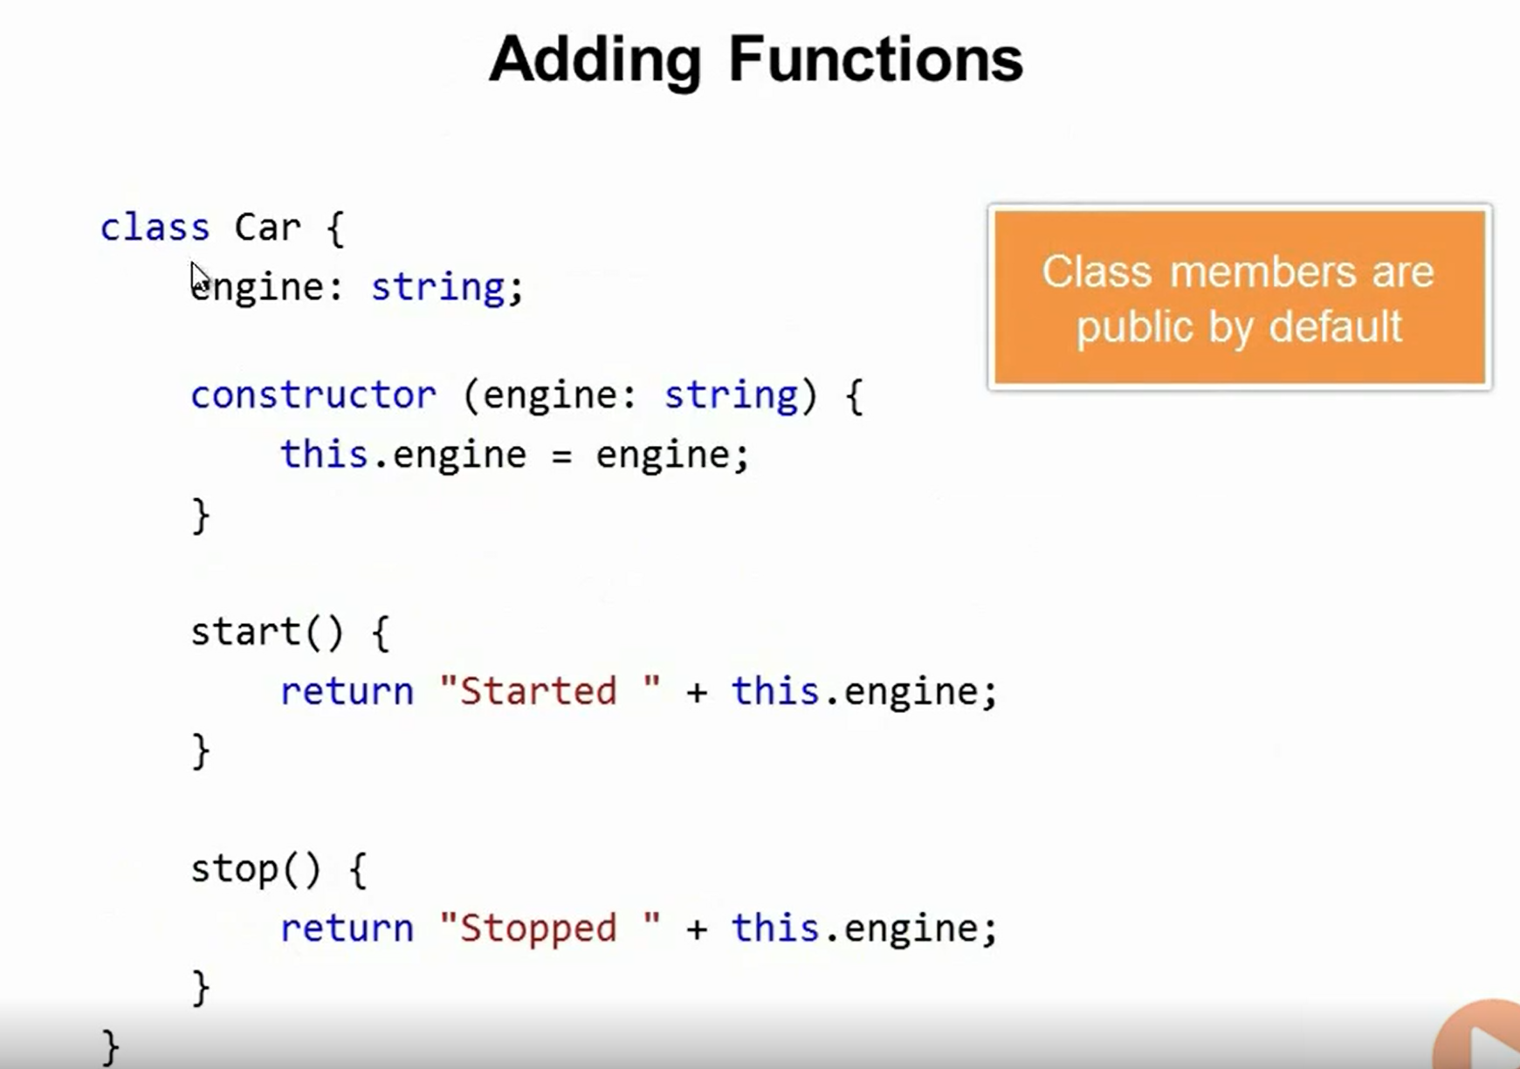

Slide 44
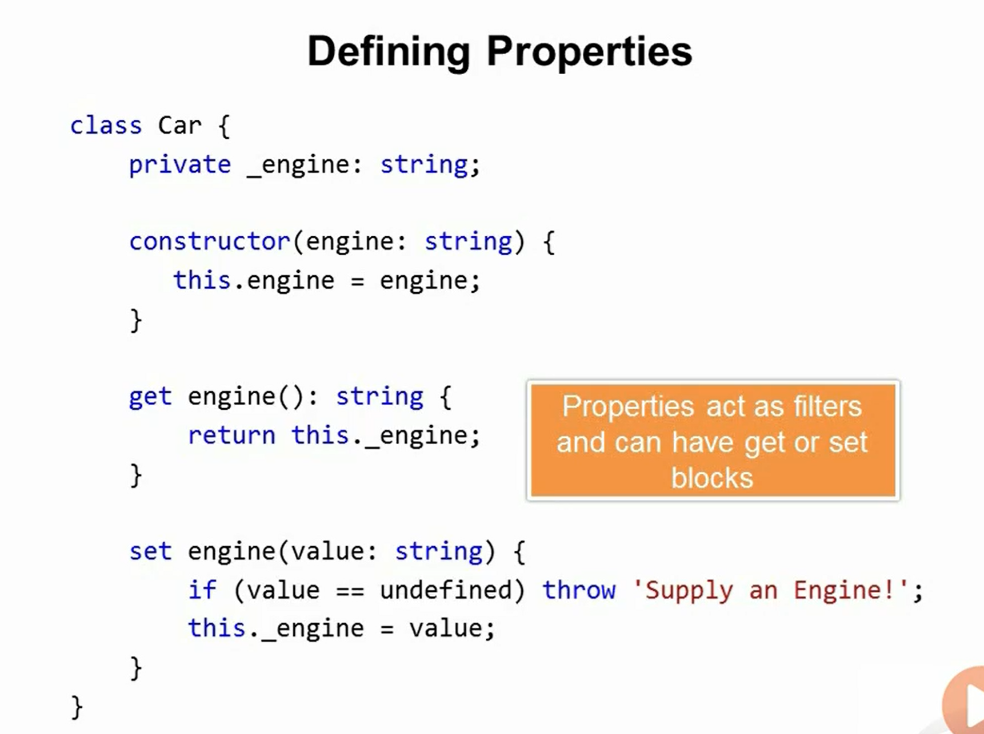

Slide 45
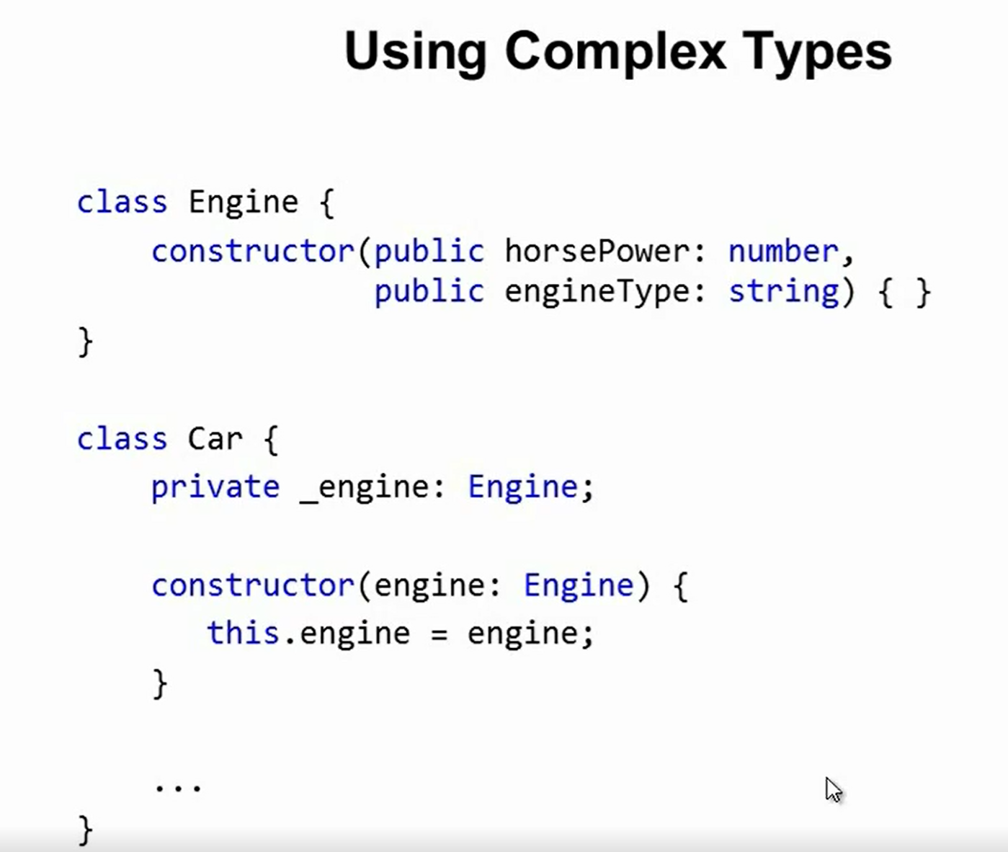

Slide 46
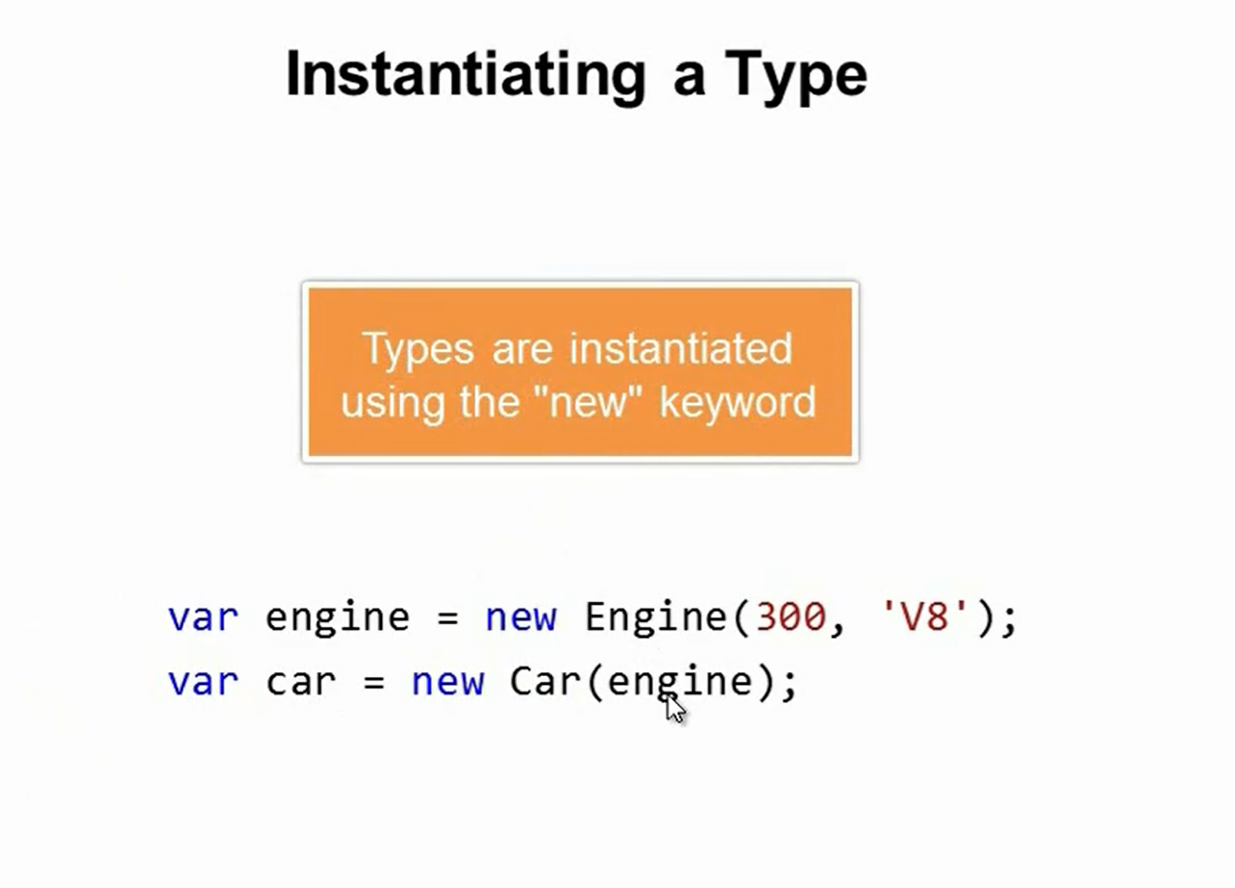

Slide 47
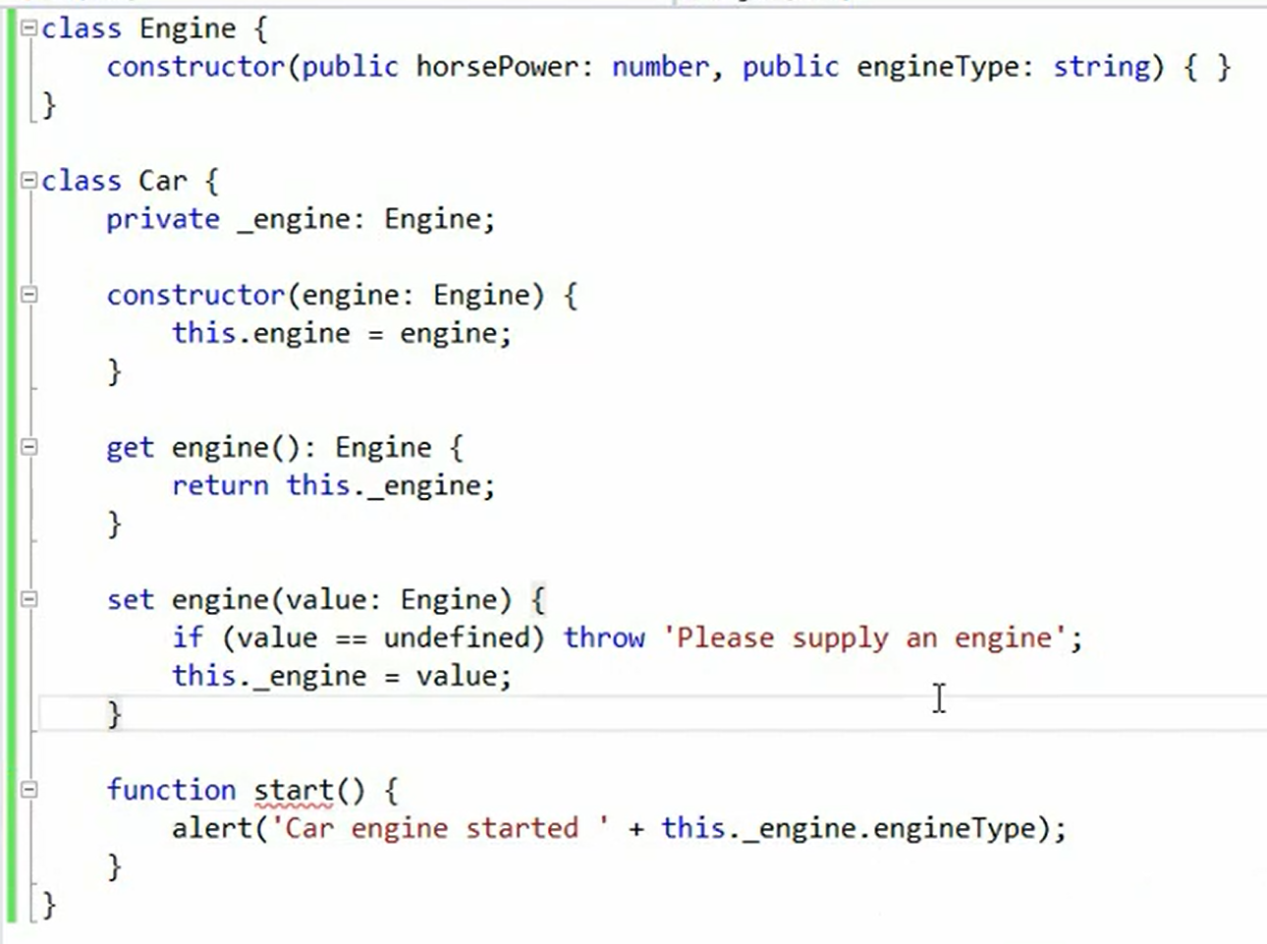

Slide 48
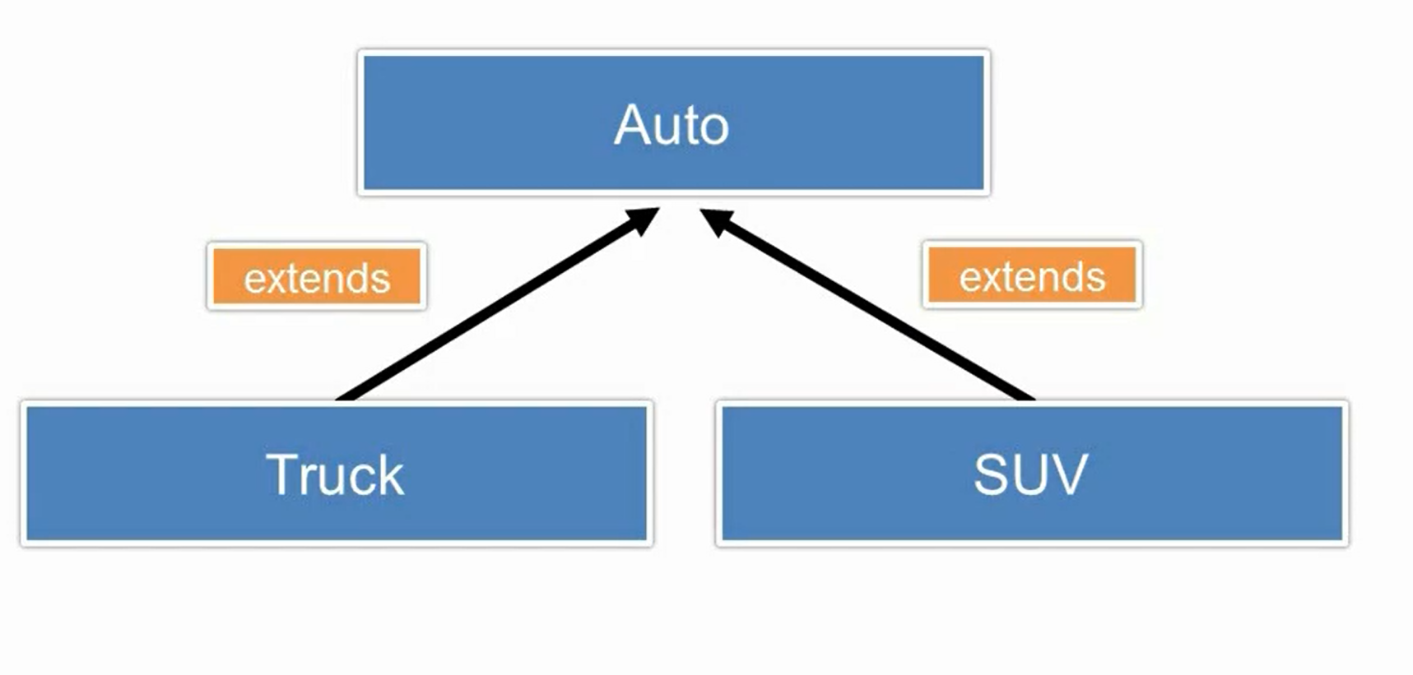
Extending Types

Slide 49
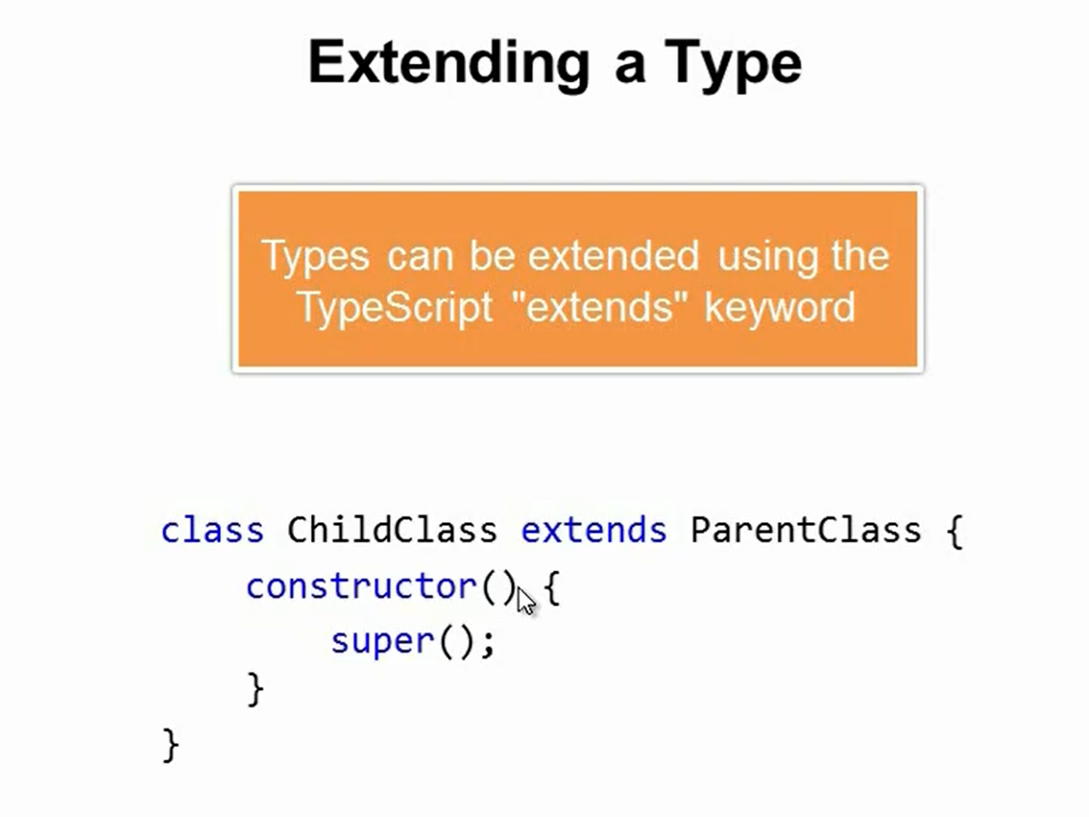

Slide 50
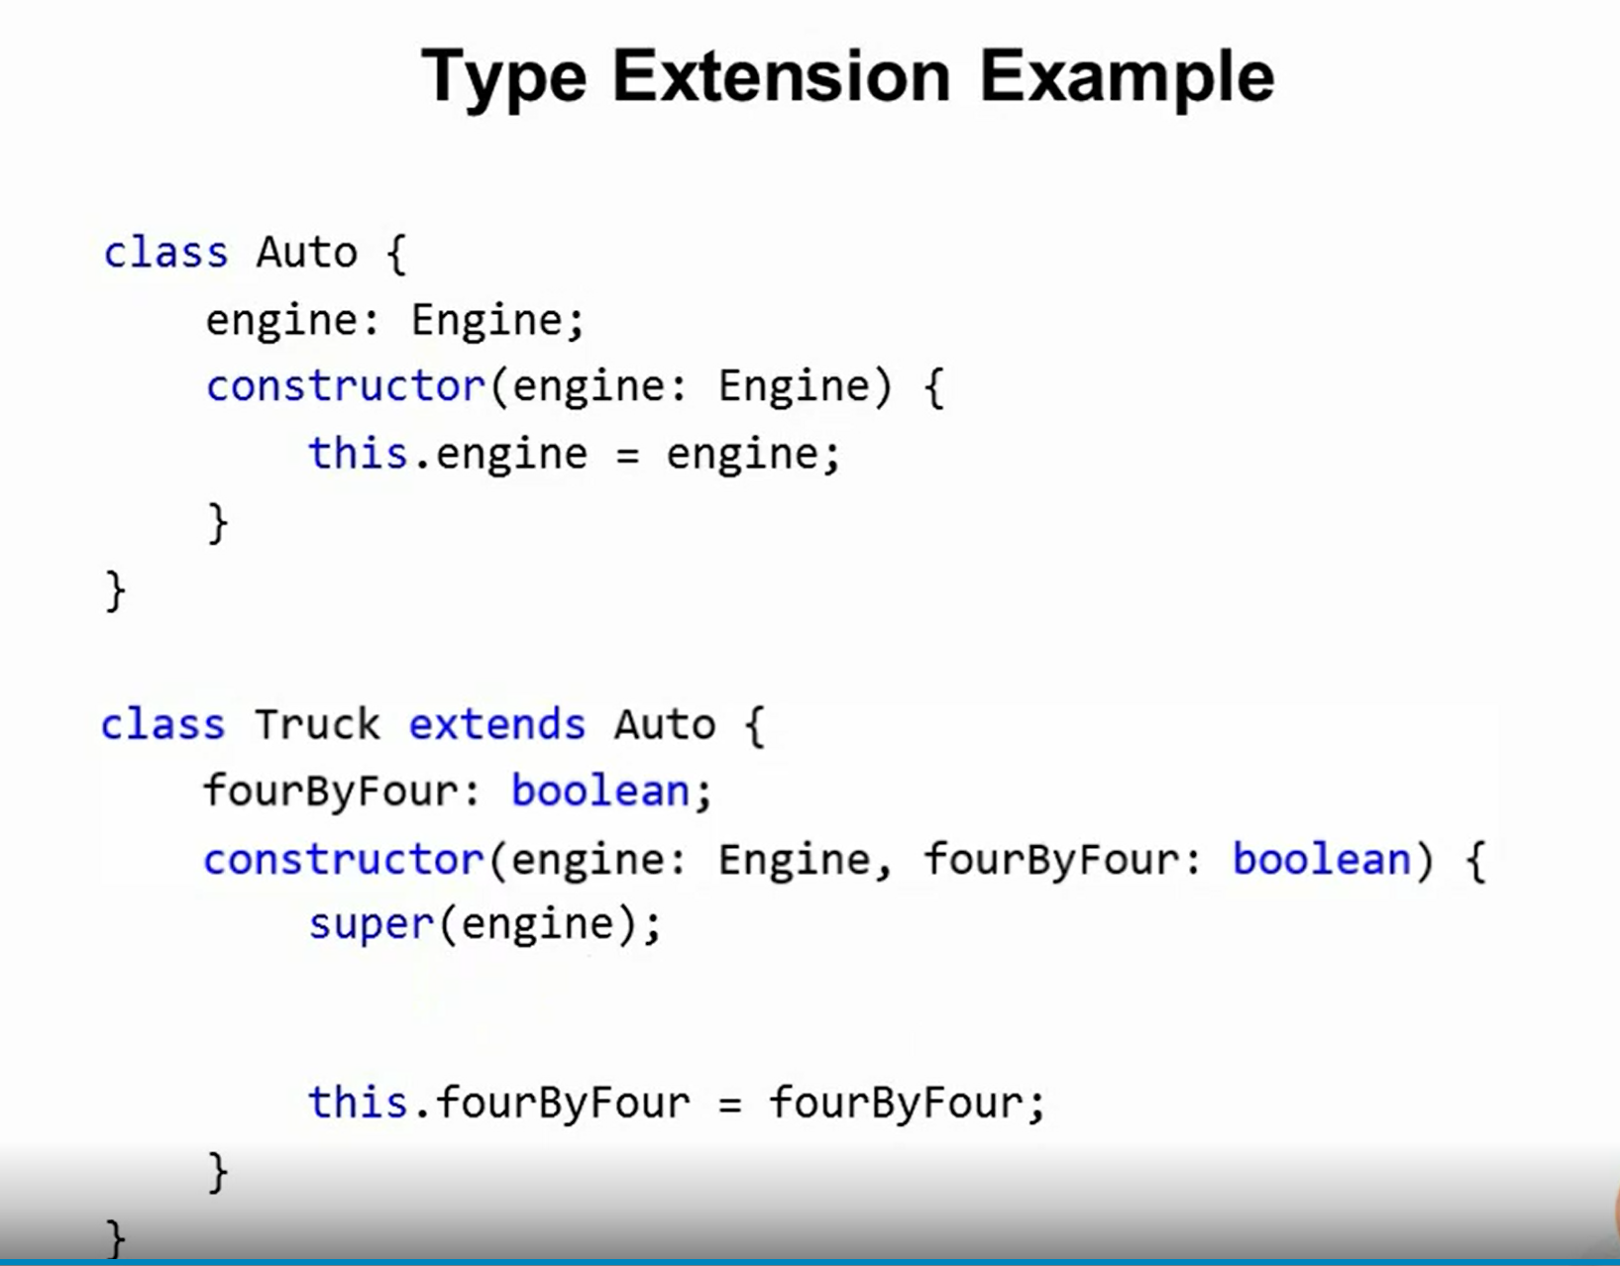

Slide 51
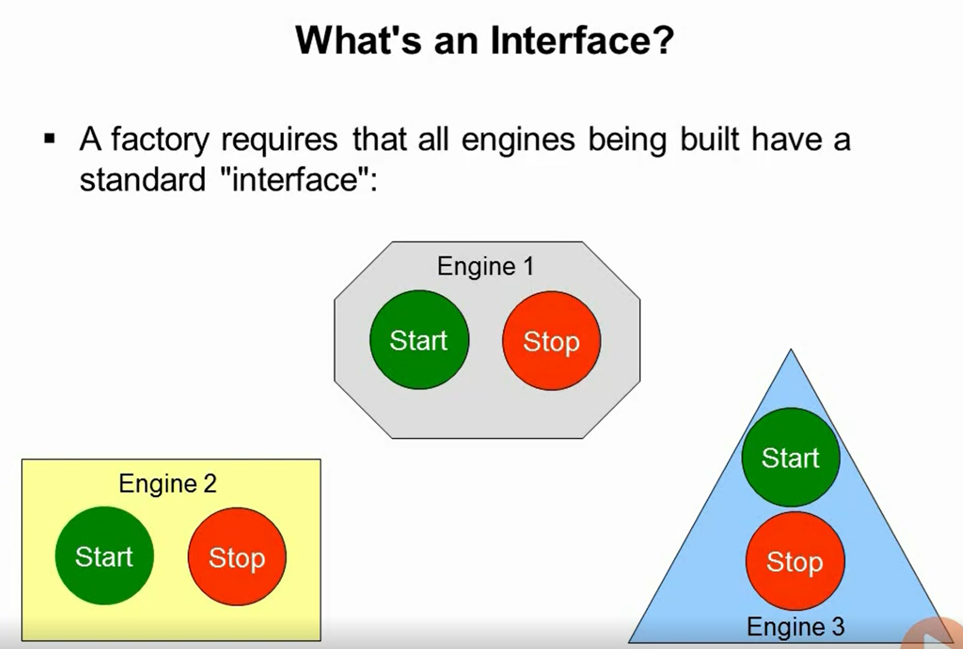
Using Interfaces

Slide 52
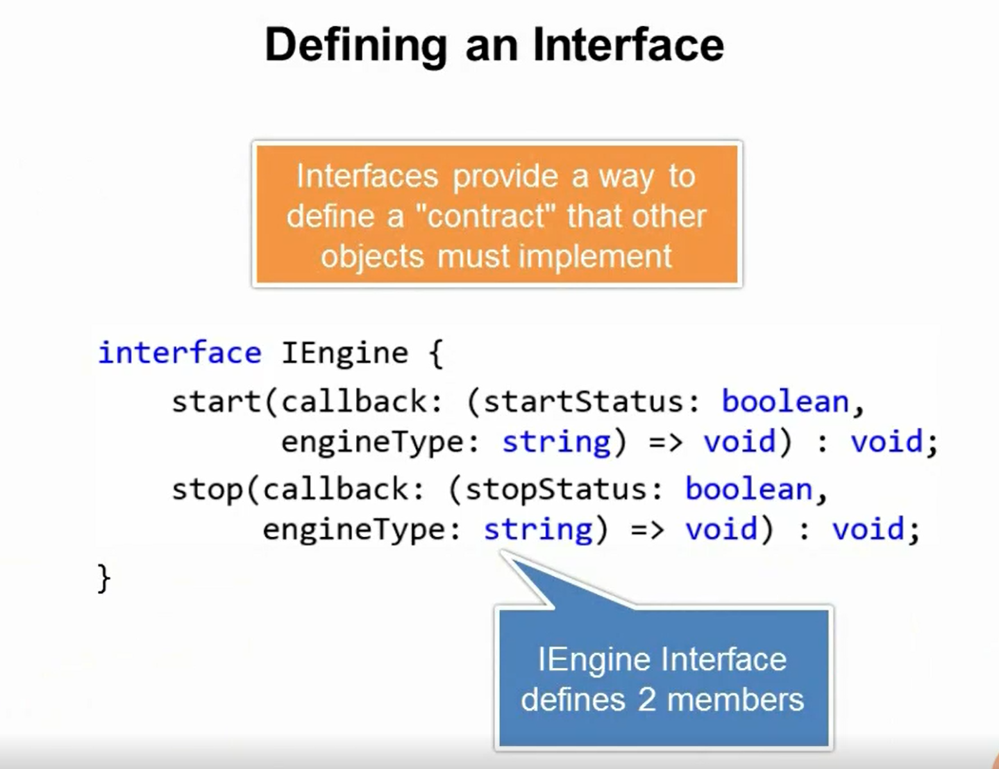

Slide 53
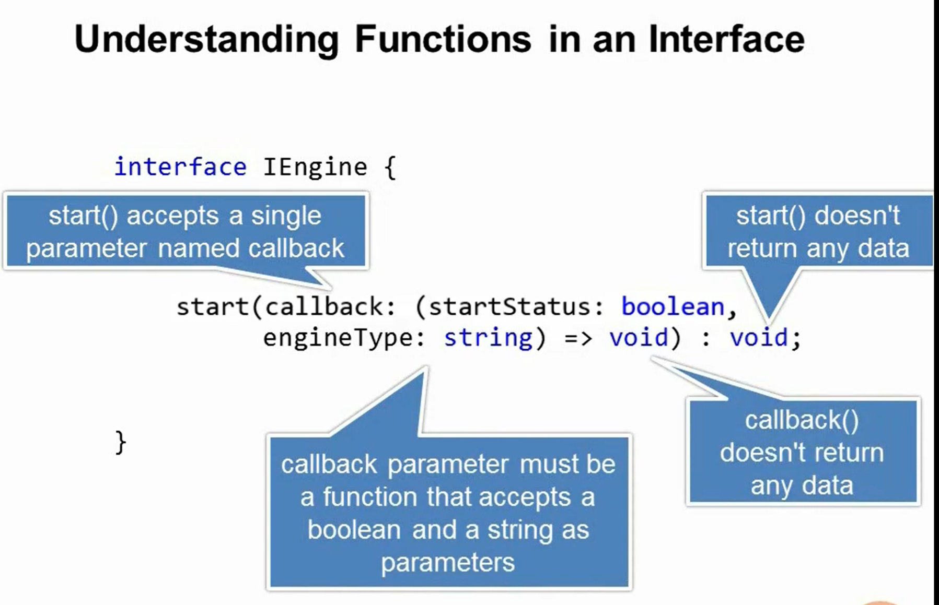

Slide 54
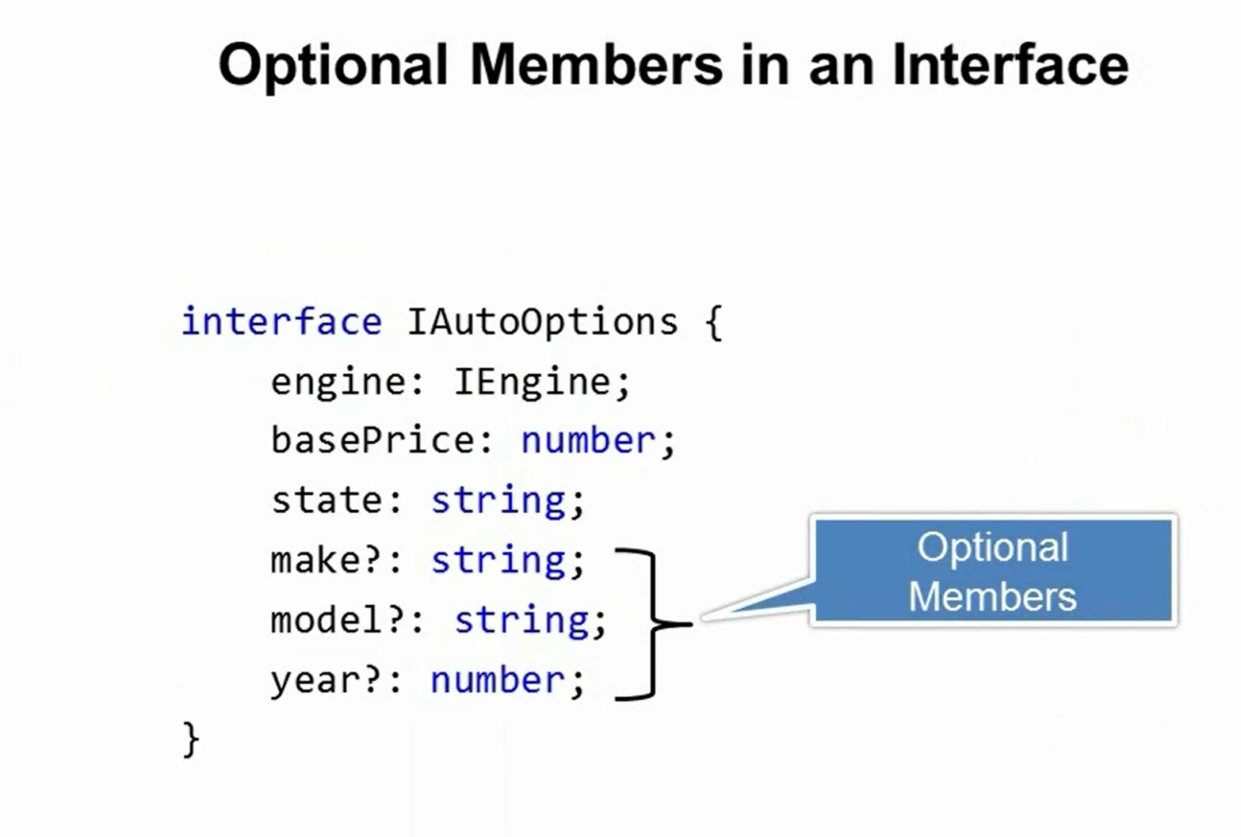

Slide 55
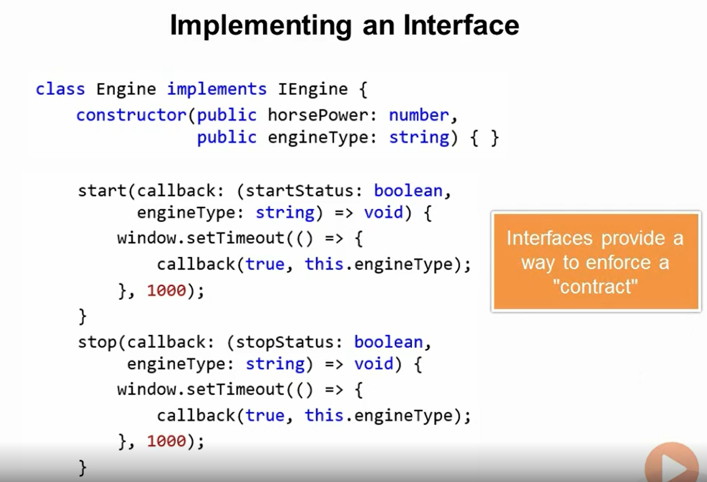

Slide 56
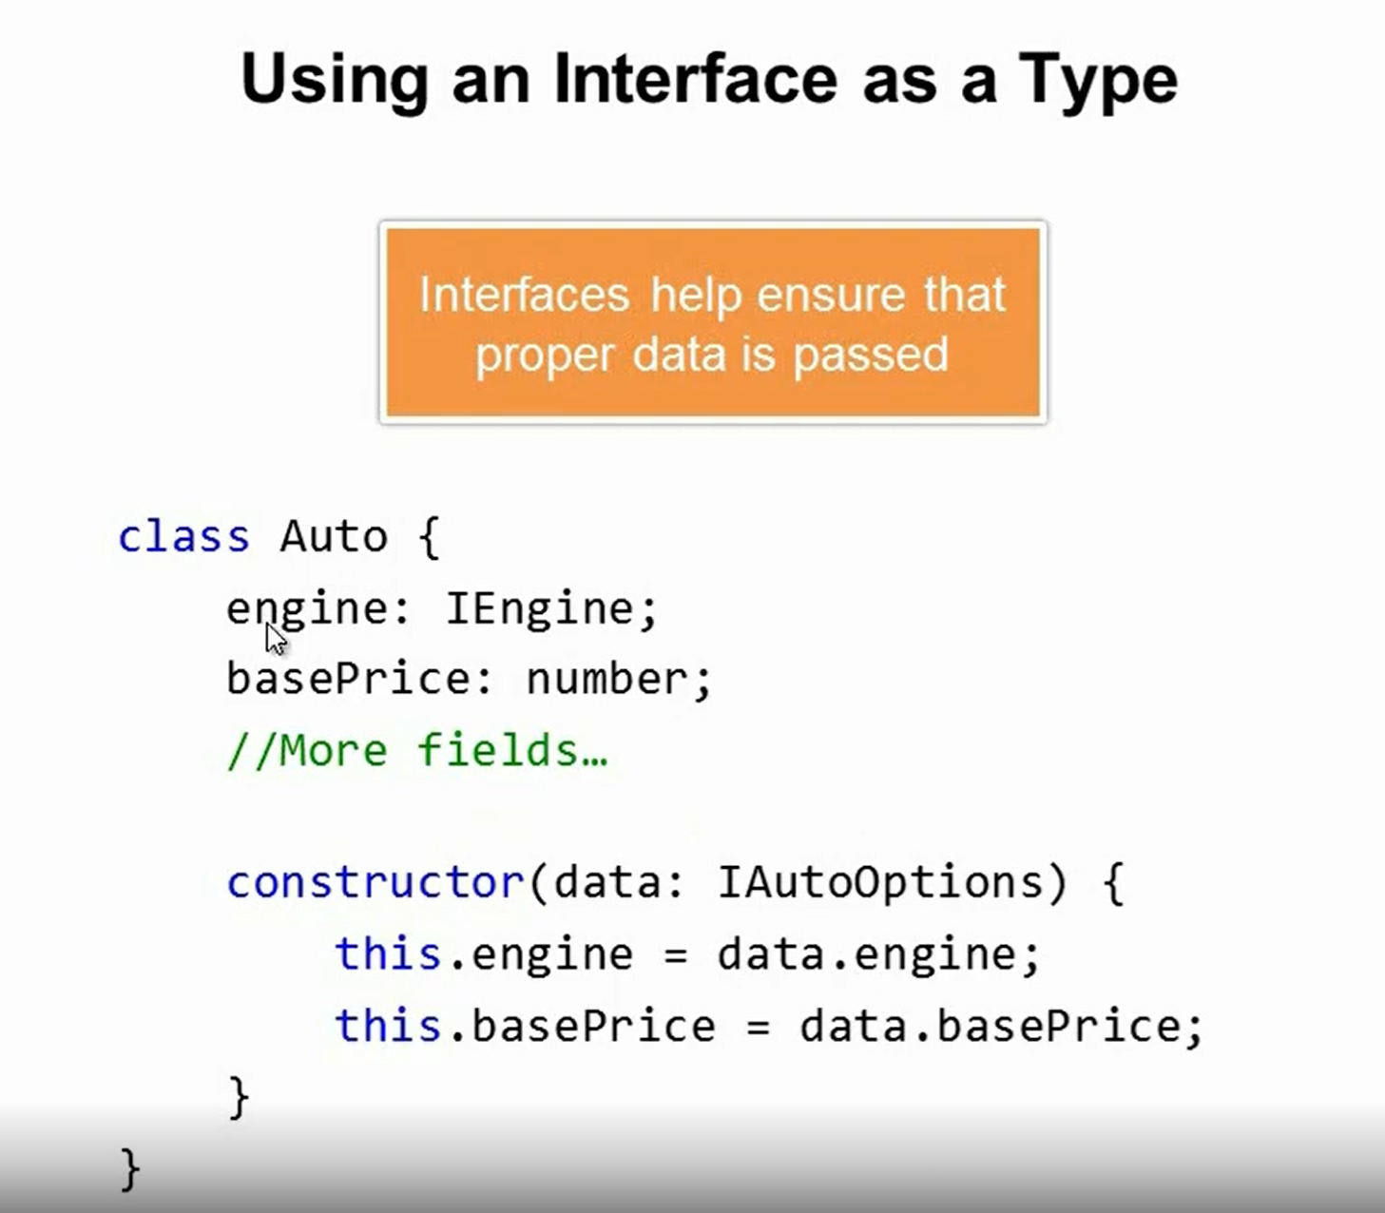

Slide 57

Extending Interfaces

Slide 58


Slide 59

Modules
Help you organize a large application into small groups

Slide 60


Slide 61


Slide 62


Slide 63


Slide 64


Slide 65


Slide 66


Slide 67

External Modules and Large Applications

Slide 68

Importing 3rd Party Libraries

